Slide 1
Future Ready Schools
What Silicon Valley Has Planned for Public Education

Slide 2
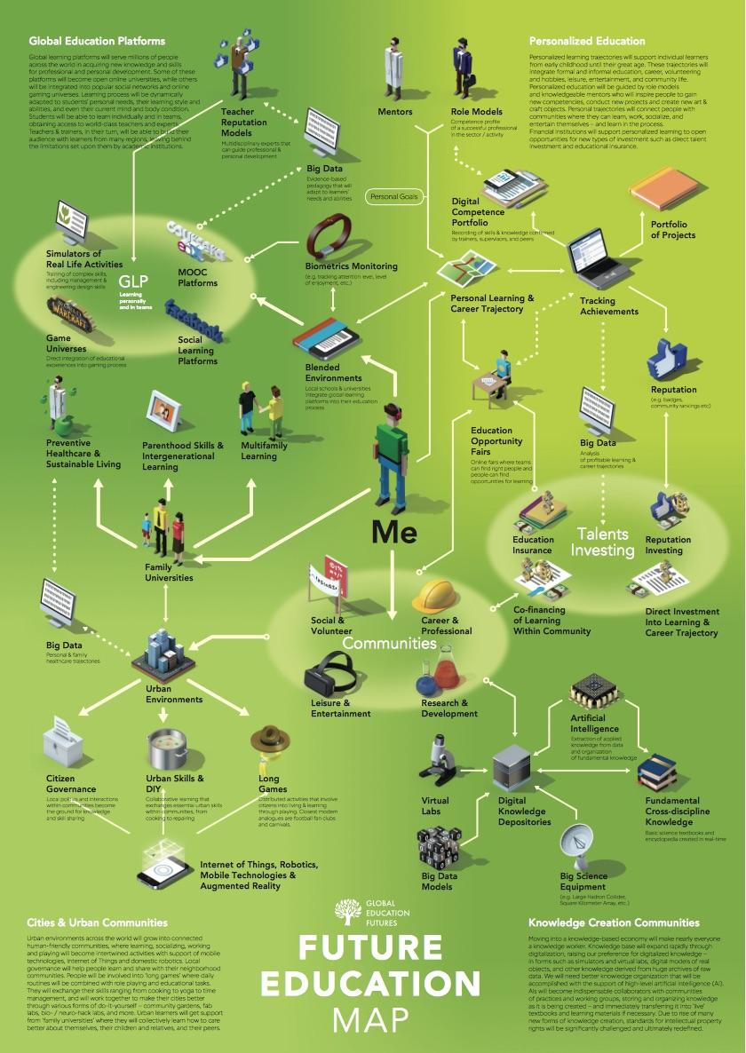
Global Education Futures foresight documents include many elements of Ed Reform 2.0.
Click HERE for the report.
Click HERE for the slideshare.
Click HERE for the essay “A Learning Day 2037.”

Slide 3
What is the end game?
Eliminate local control.
Automate the teaching profession-AI advances in service industries.
Create a new education system built on data-mining / surveillance.
Track social-emotional skills in addition to academic knowledge.
Shift to a human-capital, skills-training mindset.
Eliminate or minimize school buildings in favor of drop-in centers.
Shift to a majority cyber model with a bit of community-based learning.
Virtual wallet ESAs and badging systems will enable the ecosystem model.

Slide 4
ESSA changed the game.
We’re Dealing With Ed Reform 1.0
Vouchers
Charters
Teach for America
School Closures / Turnaround Plans
High Stakes Testing-End of Year
Value Added Teacher Accountability
Austerity Budgeting
Broad Academy Superintendents
Non-Elected School Boards
They’re Implementing Ed Reform 2.0
Learning Eco-Systems
Hybrid-Blended Learning / Teacher On the Side
Online Gaming Platforms
Augmented & Virtual Reality Simulations
“Whole Child” Data Collection-SEL & Behavior
Credit Earned Outside School (ELOs)
Standards-Based Grading
Digital Badges & Online Portfolios
Workforce Pathways
Education Savings Accounts / Blockchain / Bitcoin

Slide 5
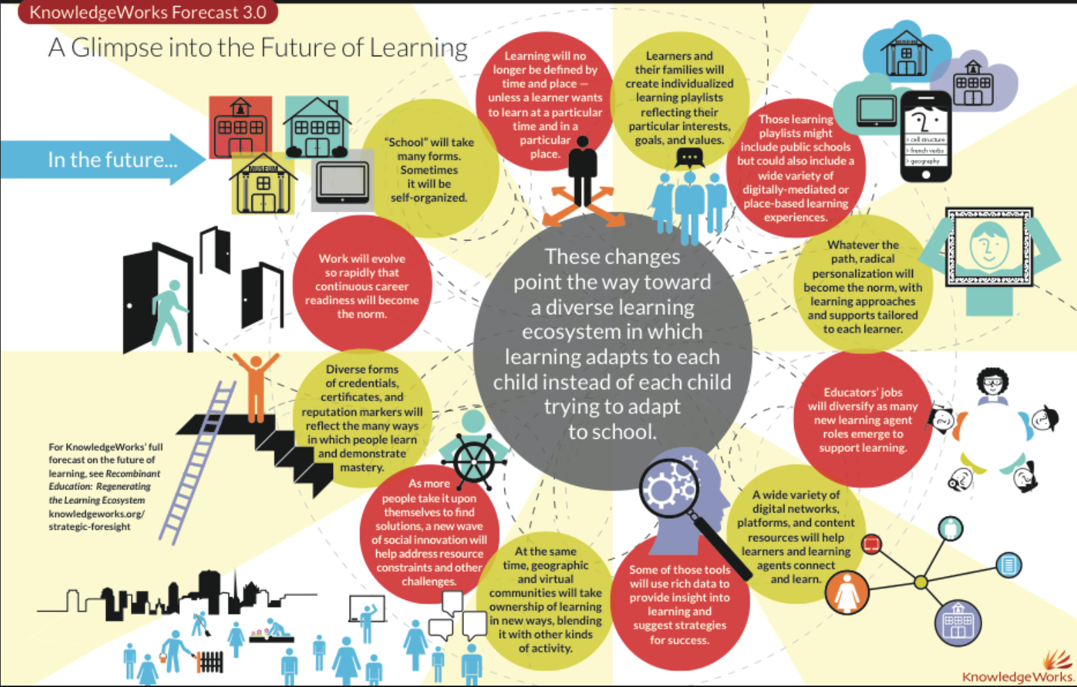
Ecosystems = Cyber Education + Community Based Learning
“School will take many forms. Sometimes it will be self-organized”
“Learners and their families will create individualized learning playlists reflecting their particular interests, goals, and values.”
“Those learning playlists might include public schools, but could also include a wide variety of digitally-mediated or place-based learning experiences.”
Infographic: A Glimpse Into the Future of Learning, Knowledgeworks 2013

Slide 6
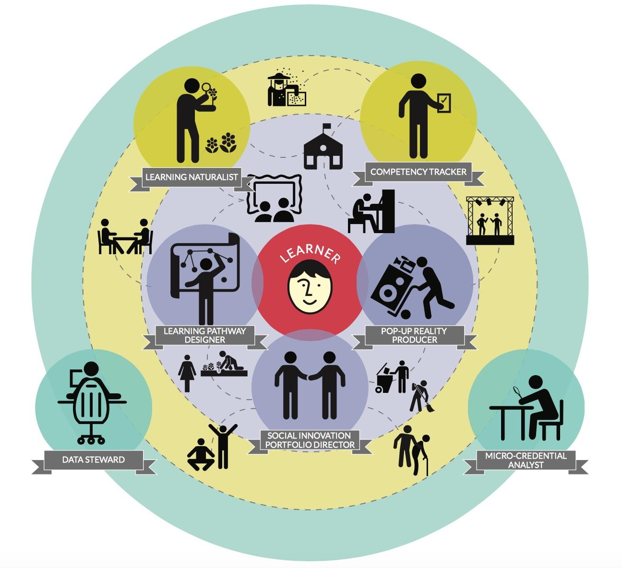
In the learning ecosystem, certified teachers could be replaced by...
Gig Economy
Benefits?
Data Stewards
Learning Pathway Designers
Competency Trackers
Learning Naturalists
Pop-Up Reality Producers
Micro-Credential Analysts
Social Innovation Portfolio Directors
Turnover & Churn
No Time to Build Lasting Relationships
Exploring the Future Education Workforce: New Roles for An Expanding Learning Ecosystem, Knowledgeworks 2015

Slide 7

Are we approaching a time when school buildings with human teachers are no longer the norm?

Slide 8
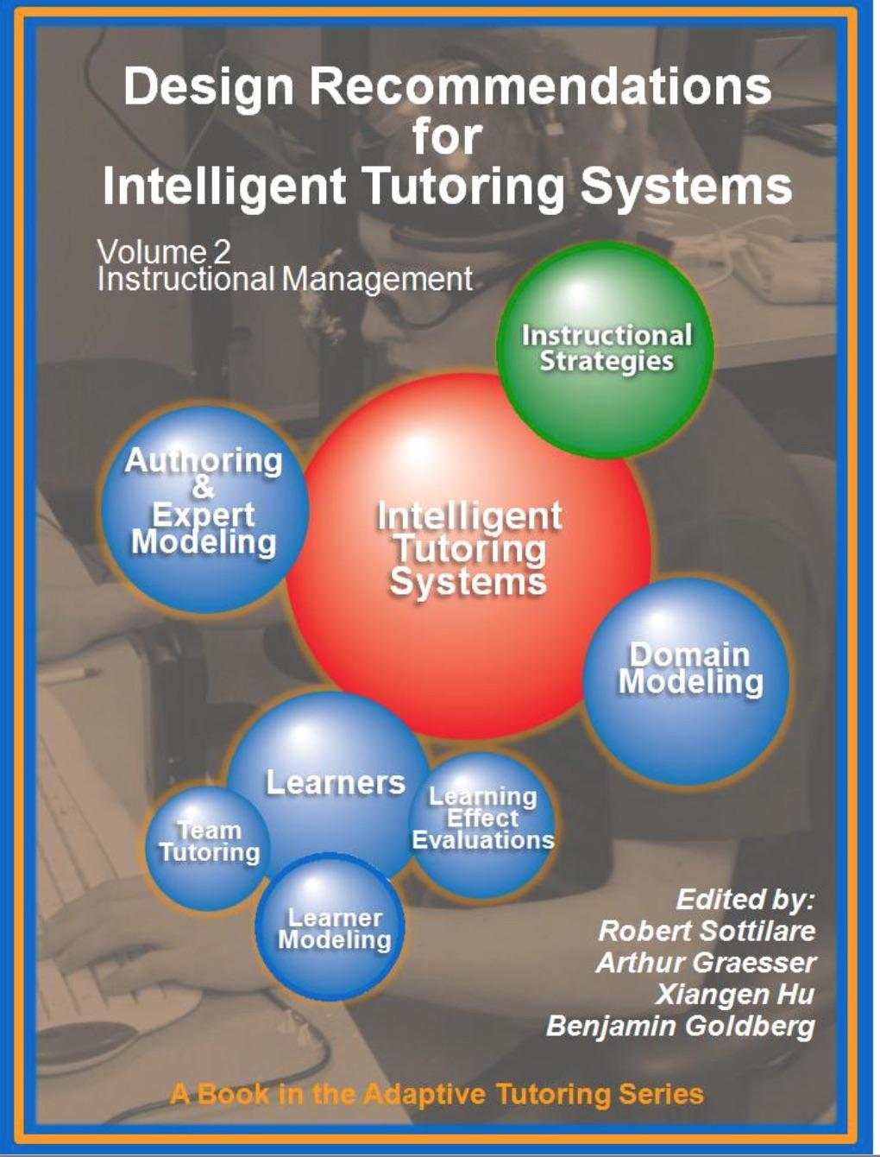
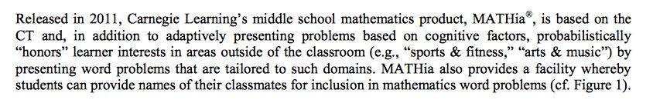
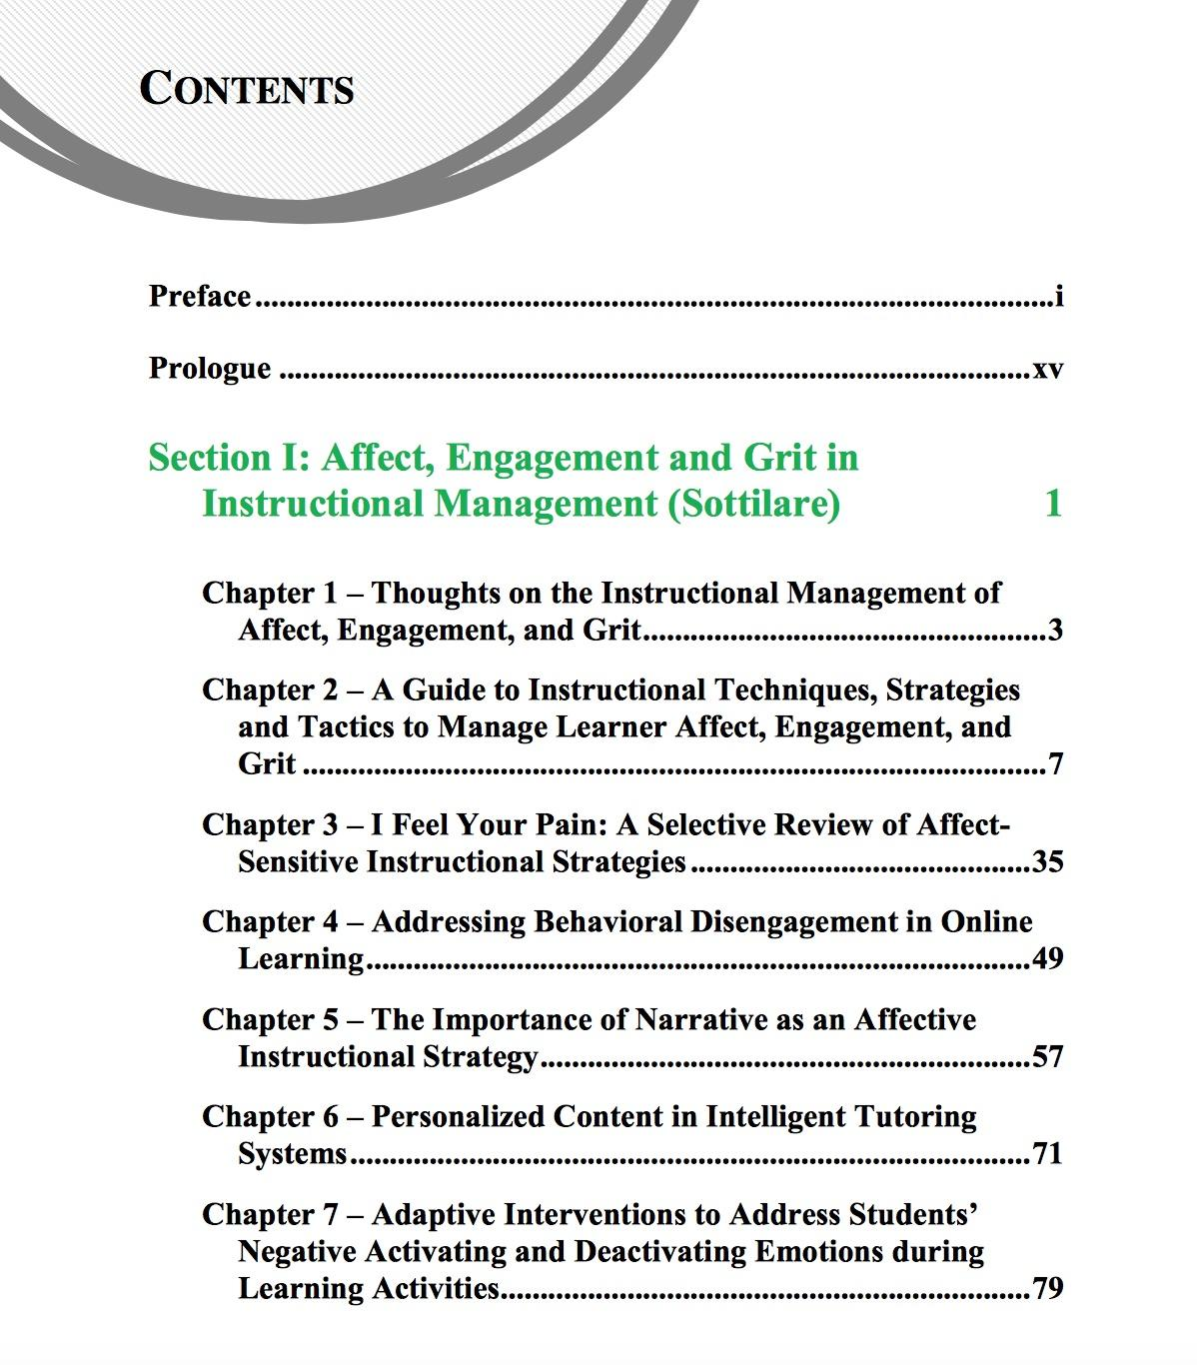
“Design Recommendations for Intelligent Tutoring Systems”
Prepared in 2014 by the Institute of Creative Technologies at USC
For the US Army Research Lab
Link

Slide 9
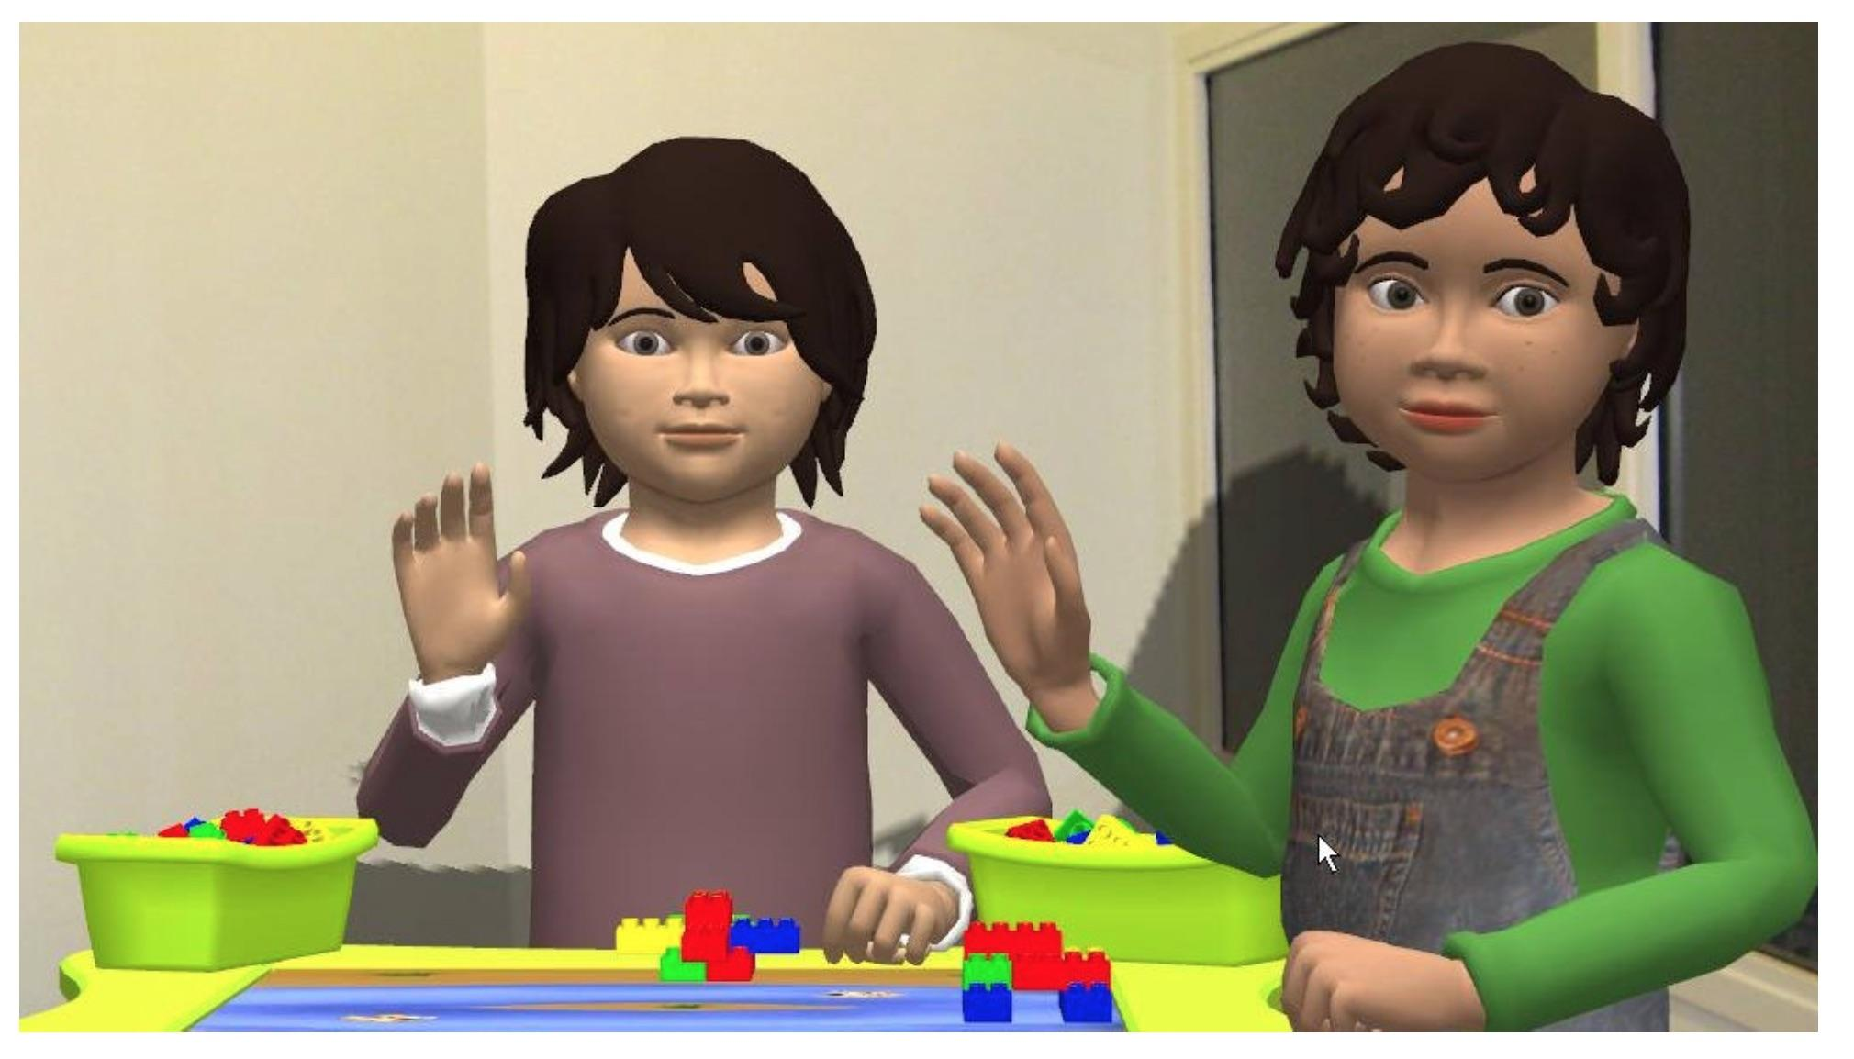


Genie, Reasoning Mind
Who’s teaching our kids?
Articulab Virtual Peers, Carnegie Mellon
TutorMate is funded, in part, by Haliburton and Booz Allen Hamilton

Slide 10
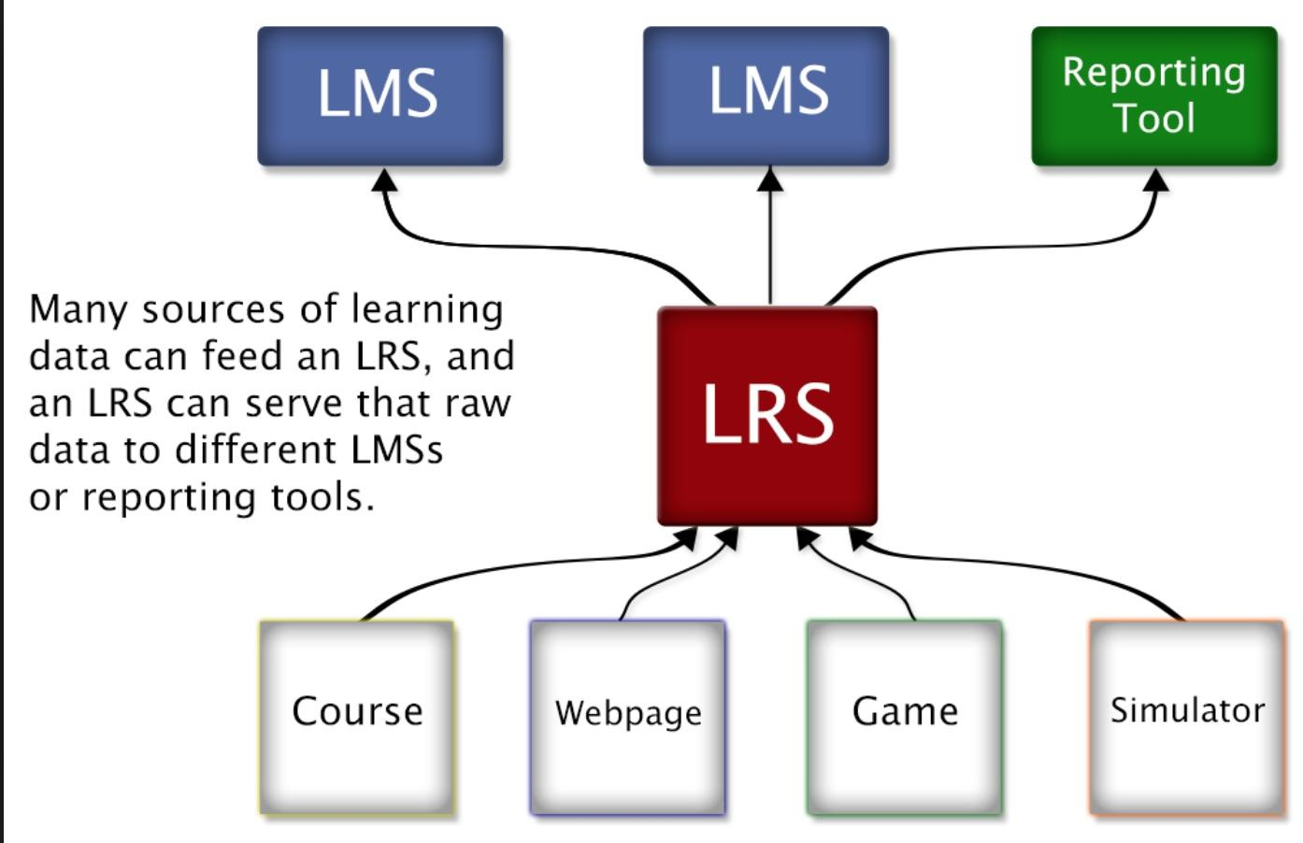
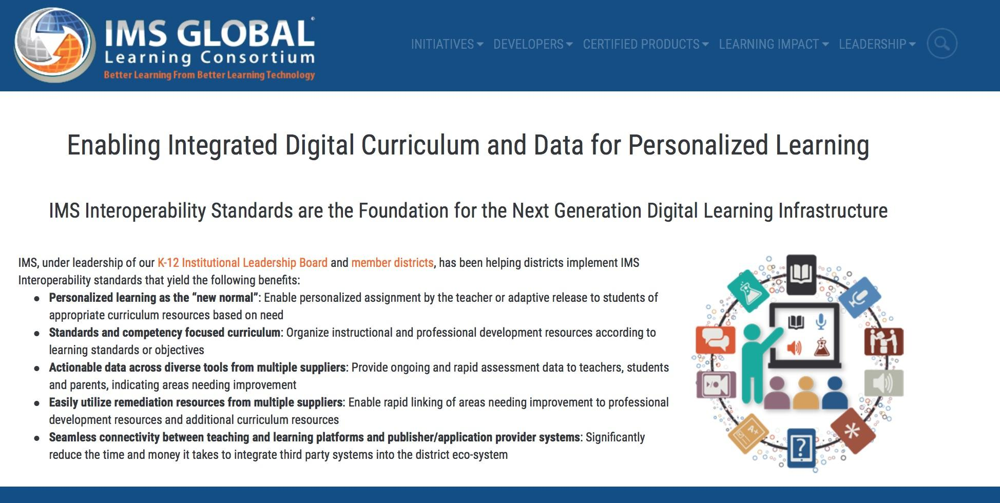
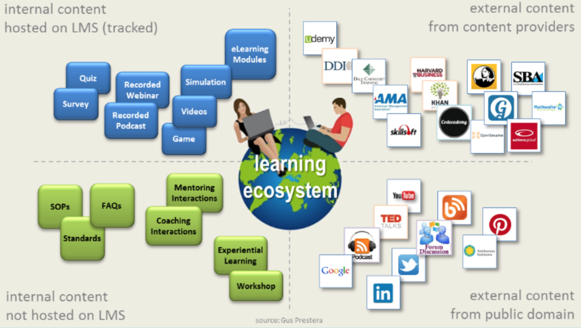
Anytime, Anywhere
Any Path, Any Pace
Learning Ecosystems

Slide 11

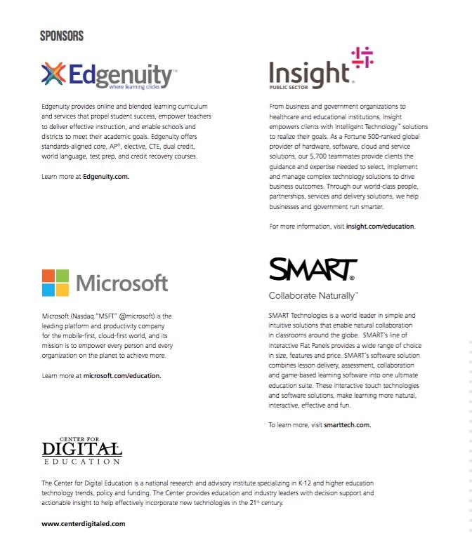
Hybrid-Blended Learning Will Normalize Digital Education / Charterizing From Within

Slide 12
“Starting in 2014, the district (Cabarrus County Schools) identified its best high school and middle school teachers, doubled the amount of students those educators teach, cut the in-person time with these students in half and paid the teachers more to reach more kids and get the same results.”
Page 13, “Making Blended Work”

Slide 13
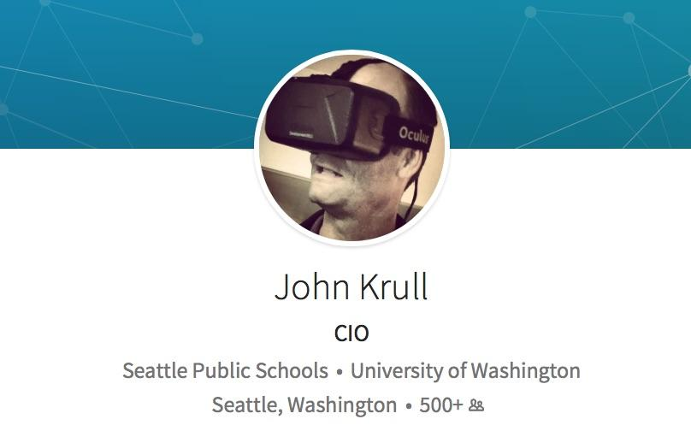
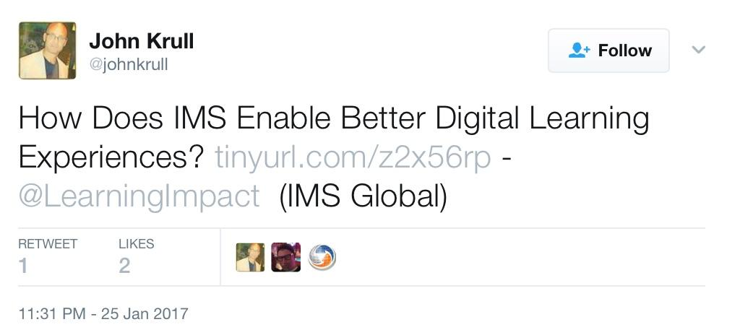
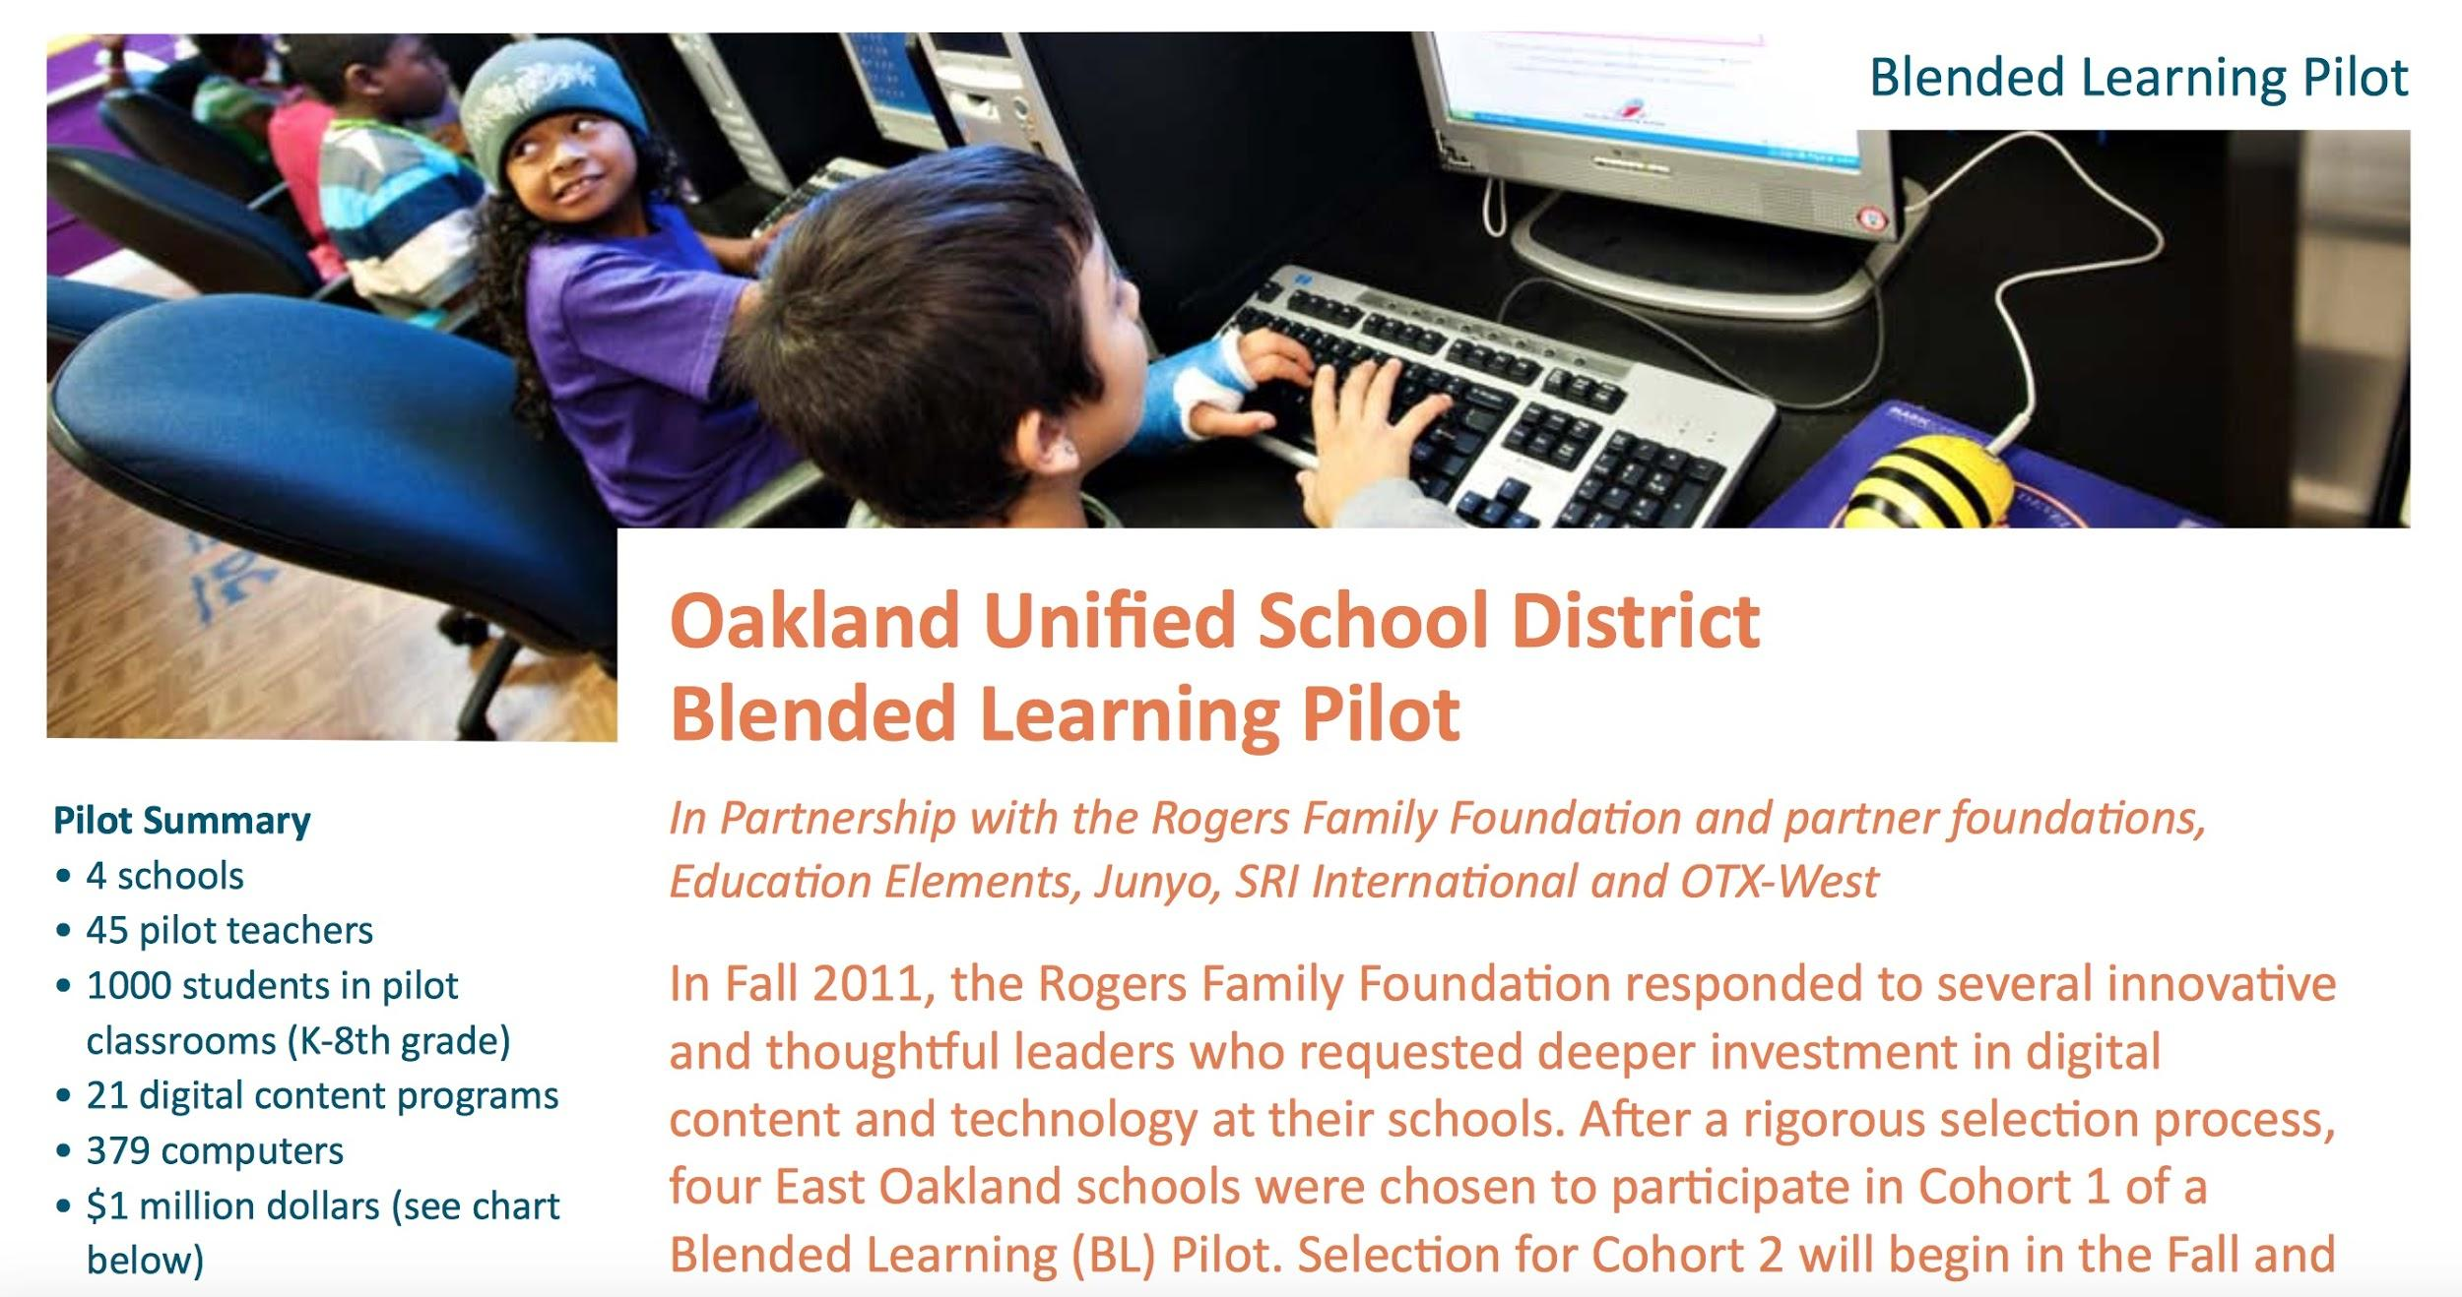
Austerity
Shift to OER
#GoOpen
Playlist Education

Slide 14

Pearson Pushing AI
(Artificial Intelligence)
Automated Teaching Personalized Learning
Pearson owns Connections Academy
Cyber Charter
Operating in 29 States Now
Connections Learning = Vendor for “Public” Cyber Schools

Slide 15
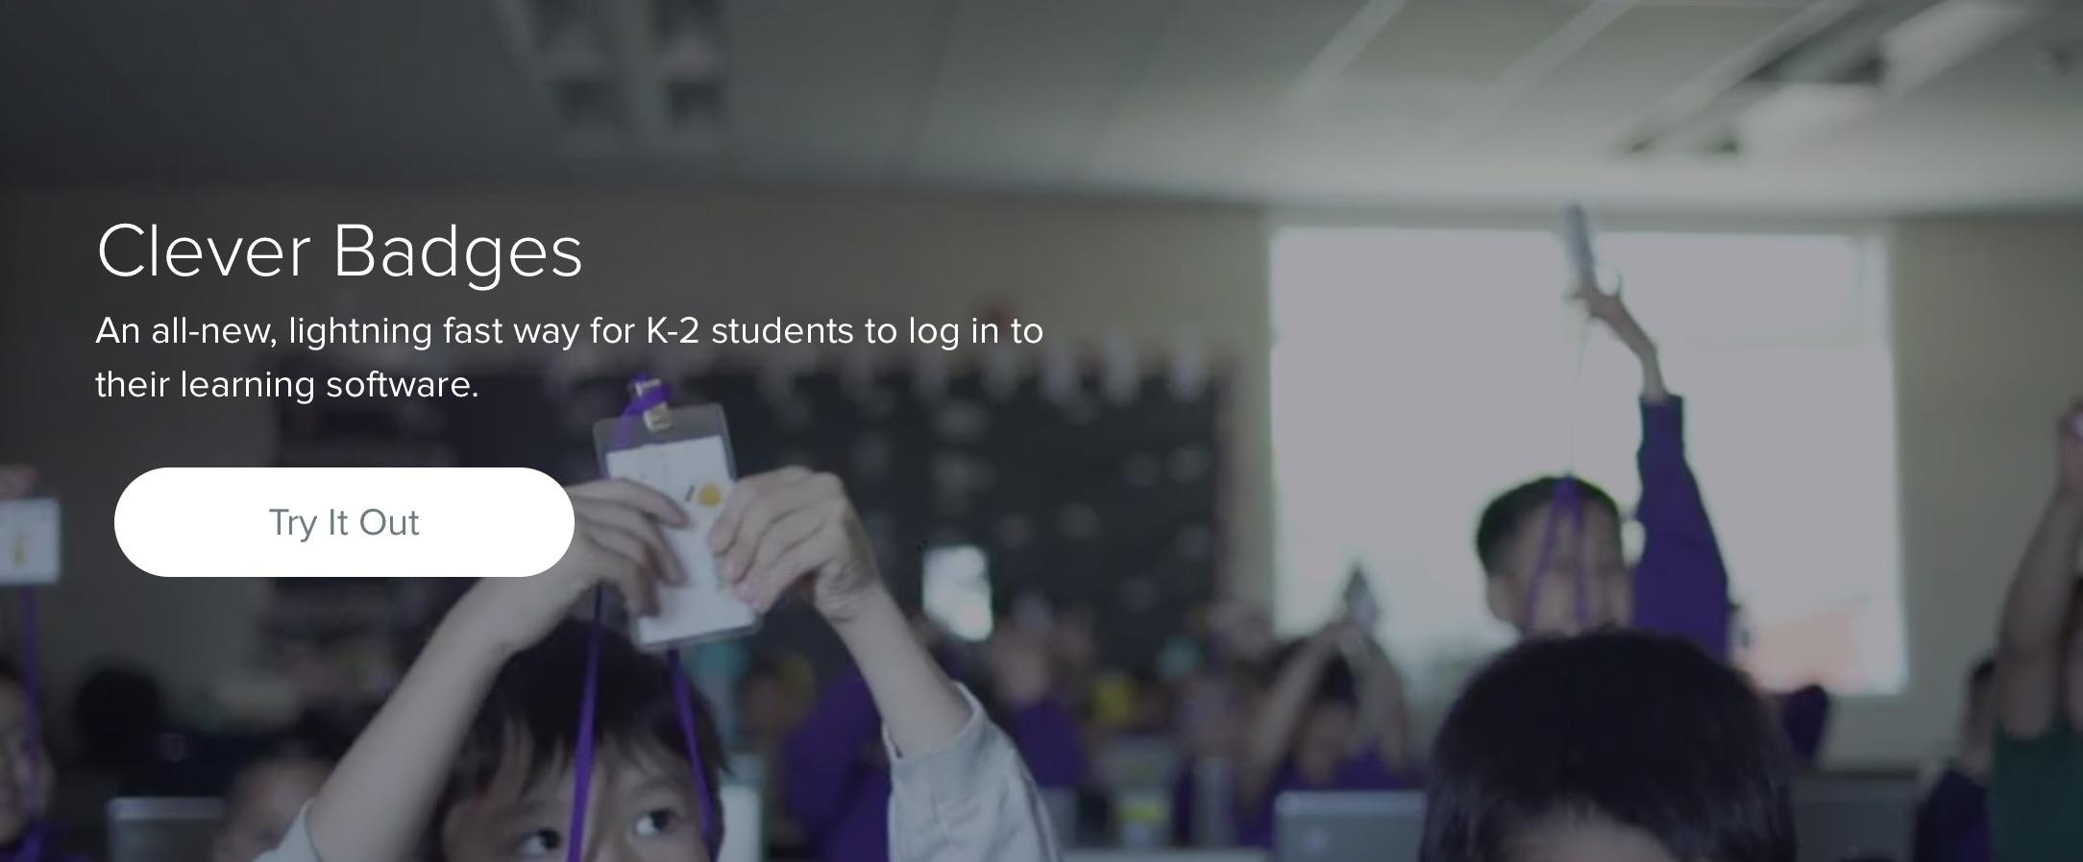
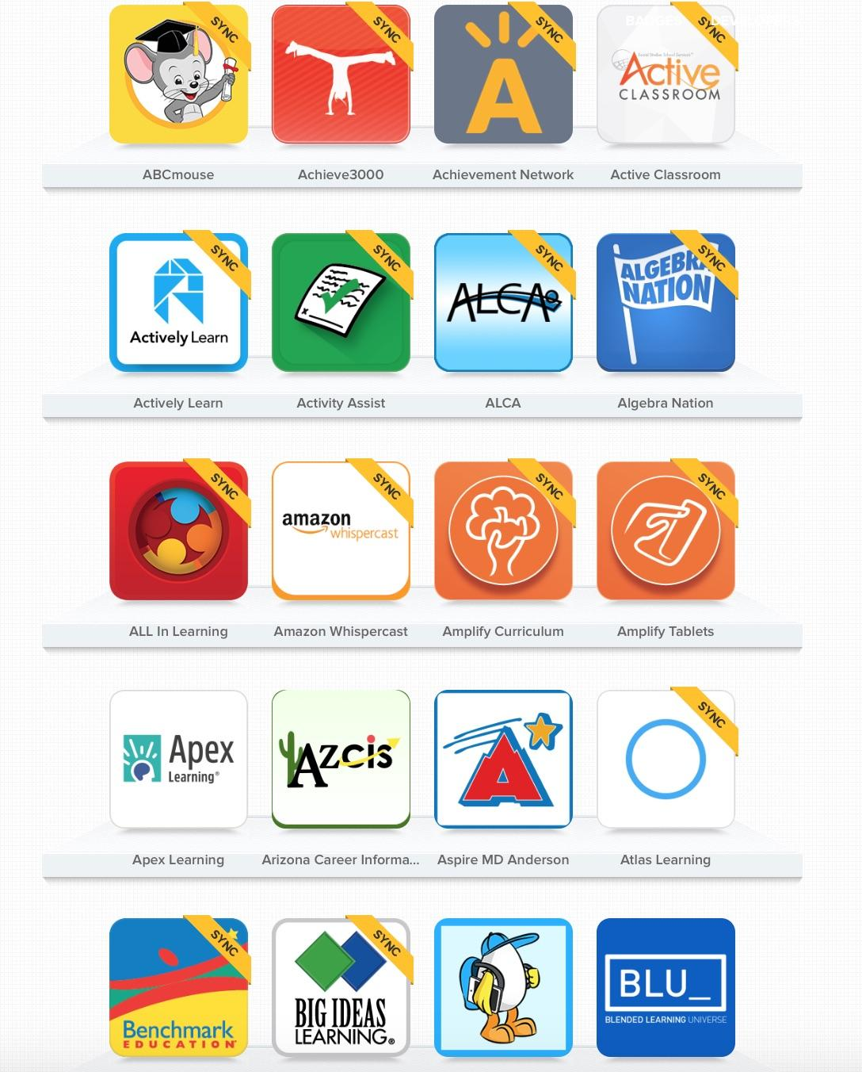

Children too young for log-ins are given badges.

Slide 16
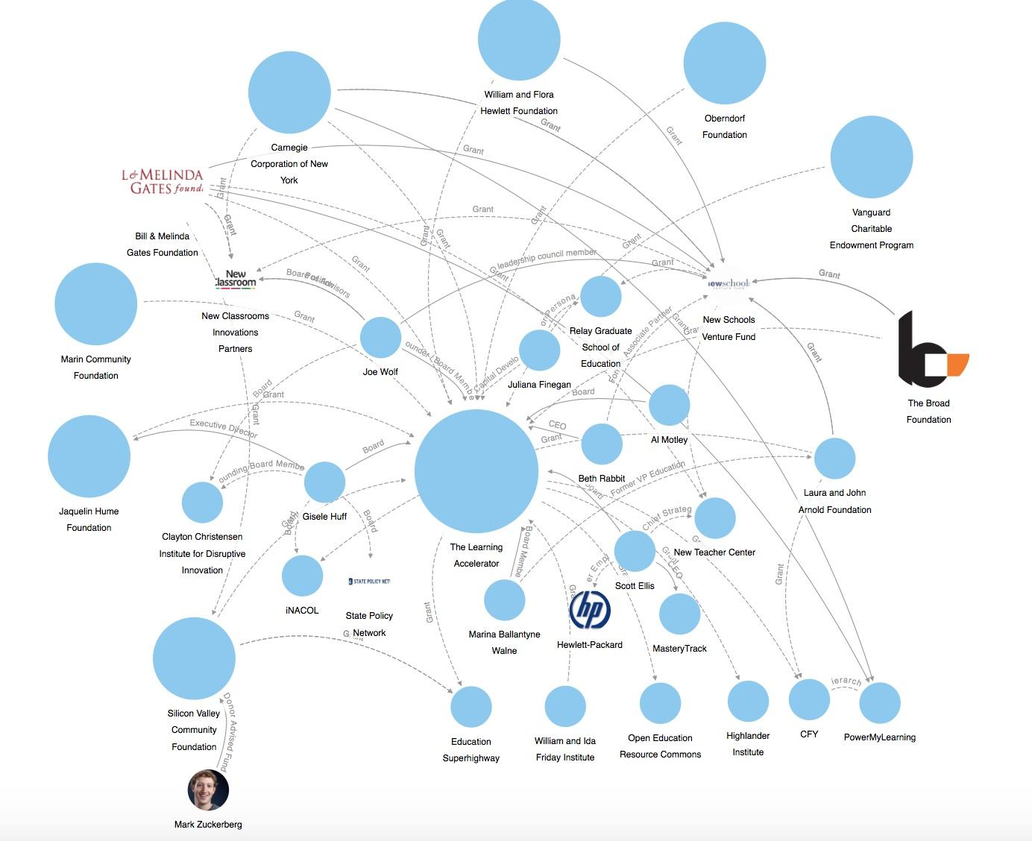
Its Funders = Large Dots
The Learning Accelerator
Paving the way for Blended Learning
Funding:
Broadband Access, E-Rate
Supportive Research
Open Education Resources
Blended Learning Platforms
Professional Development
Computers in Homes

Slide 17
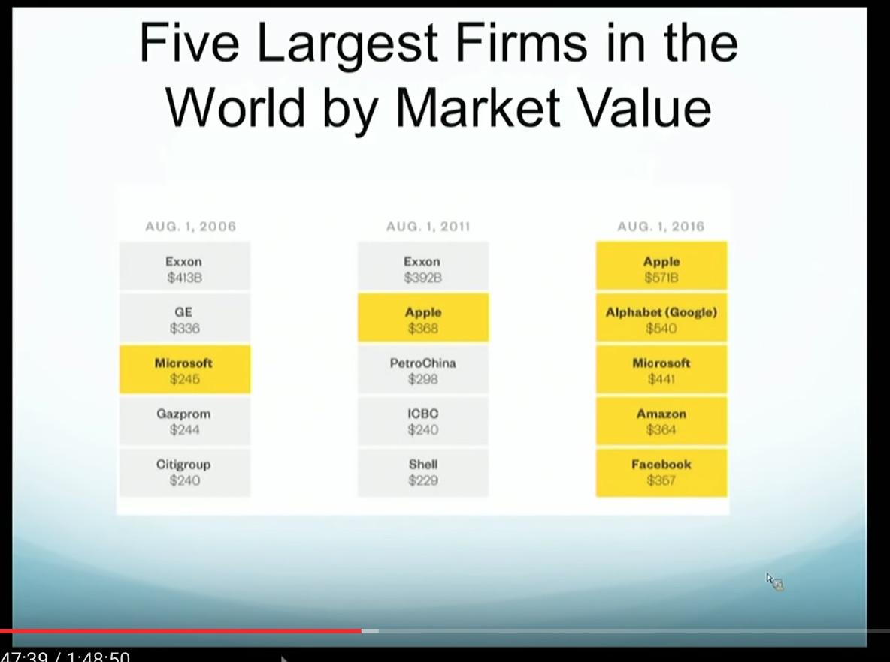
August 1, 2006
Microsoft
August 1, 2011
Apple
August 1, 2016
Apple
Alphabet (Google)
Microsoft
Amazon
Facebook
From Vincent Mosco’s Talk:
Take Me to Tomorrowland: The Cloud, Big Data and the Internet of Things
University of Ottawa 9/19/16

Slide 18
Playlist Education
Personalized Pathways
Department of Defense
Silicon Valley
Research Universities
Telecommunications/ Broadband
Foundations
Cultural Institutions
Business / Workforce Interests
Global Finance “Pay for Success”

Slide 19
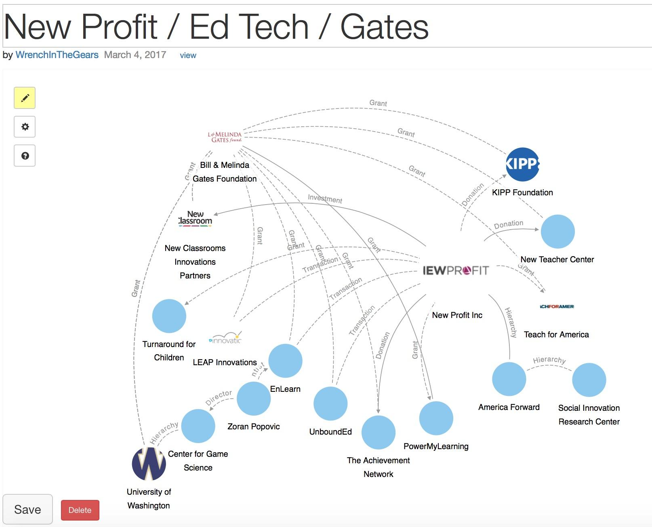
Gates Funds All But 1 of These, Too
Pioneered “Pay for Success” in US
Blended learning Investments

Slide 20
Use a critical lens to examine the role of technology in today’s classrooms
Who created these technologies? Gates, Zuckerberg, Bezos, Thiel, Hastings…
Ultimately, whose interests are served by school redesign for a digital age?
Do “free” ed-tech tools perpetuate power imbalances?
Do they offer children and teachers freedom or subjugation?

Slide 21

This is our future if we don’t start speaking up.
Building the Future of Education, p. 12
“If, in the future, more of our children grow up to be TaskRabbits, that may affect the kind of education, training and real-world experience they need to succeed in the odd-job workforce.”
This video was produced in partnership with “Institute for the Future” a RAND spin-off from the 1960s. Despite the somewhat corny nature of the acting IFTF has many high-powered partners.

Slide 22
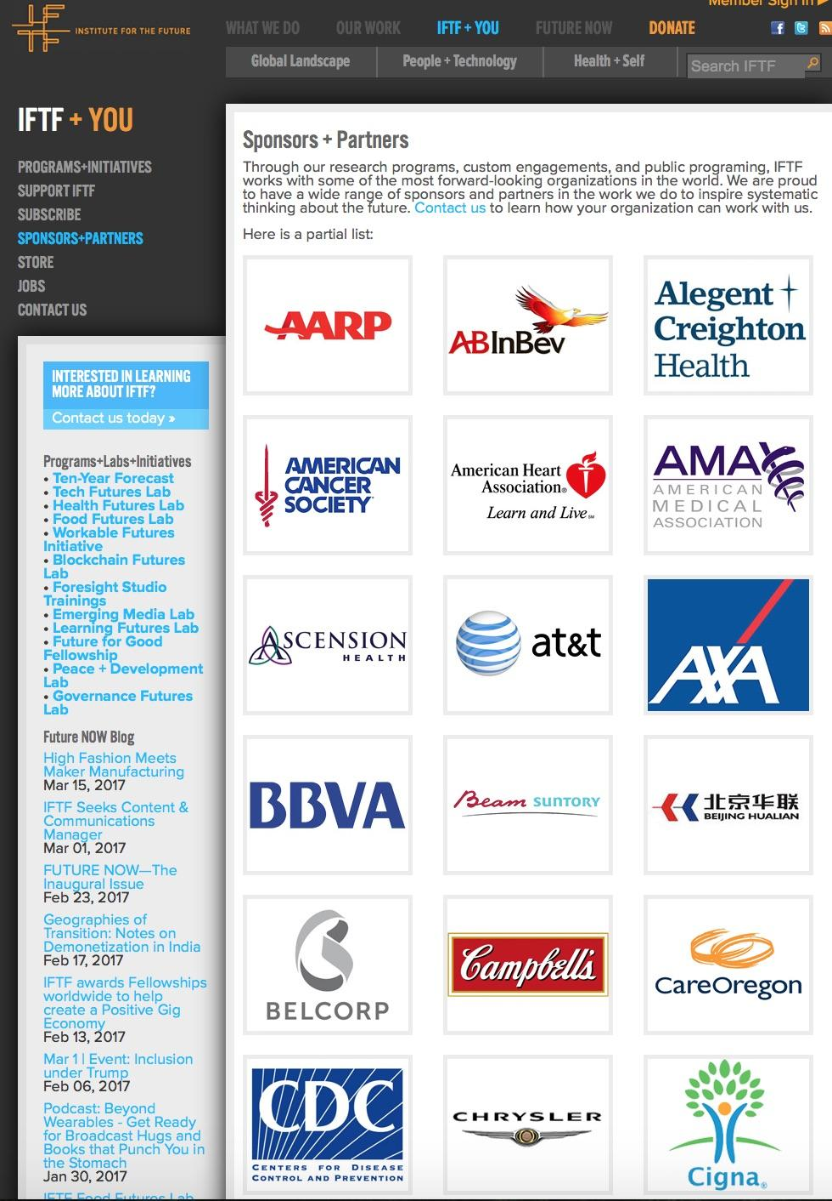


Institute for the Future’s Partners (Partial List)

Slide 23
HUMANITY
?
FREE WILL
Big Data Quantified Self
Learning by Algorithm

Slide 24
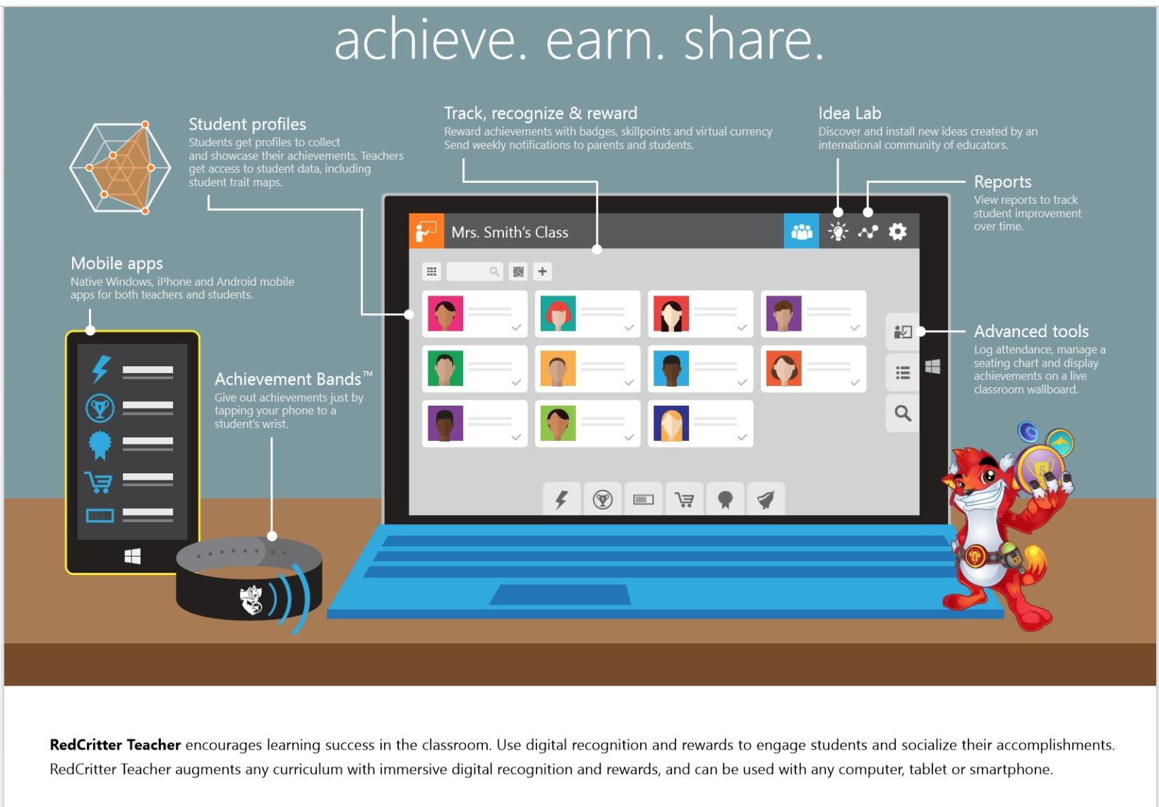
Data-Driven Education Prioritizes Devices over People
Red Critter
Teacher Version
Behavior Shaping
Achievement Wallboard
Parent Notifications
Phone/Achievement Bands
Token Economy
Badges
Skillpoints
Virtual Currency

Slide 25
Devices are continuously watching and listening.
“It was terribly dangerous to let your thoughts wander when you were in any public place or within range of a telescreen. The smallest thing could give you away. A nervous tic, an unconscious look of anxiety, a habit of muttering to yourself – anything that carried with it the suggestion of abnormality, of having something to hide...There was even a word for it in Newspeak: facecrime, it was called. The Party’s surveillance tactics and technology are so advanced that even the smallest twitch can betray a rebellious spirit.”
George Orwell, 1984

Slide 26
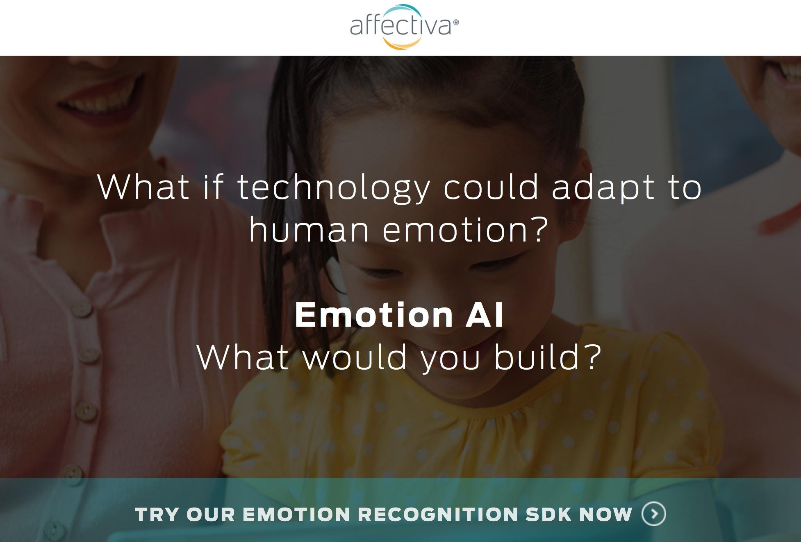
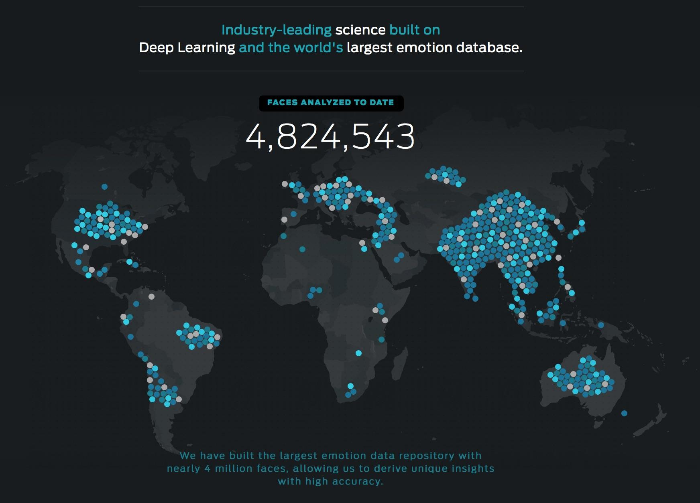
Tracking gestures and key points on the subject’s face, Affdex is able to analyze subtle movements and correlate them with complex emotional and cognitive states. This is much more than simple facial recognition. The Affdex system can identify and follow dozens of precise locations on an individual’s face. The muscular micro-shifts of every smile, yawn, or moment of confusion are captured and reflected in the data.

Slide 27
Origins of A National Cyber Education Program
Section 6: Establishment of Advisory Committee on Expanding Training Opportunities
Section 6(3): mechanisms for the Federal Government to encourage private sector investment in the development of high-quality instructional software and wider deployment and utilization of technology-mediated instruction so that all Americans may take advantage of the opportunities provided by learning technology.
Bill Clinton’s Executive Order 13111
“Using Technology to Improve Training Opportunities for Federal Employees”
It also created the
Advanced Distributed Learning Program or ADL
Signed January 14, 1999

Slide 28

Origins ADL in the Department of Defense
“The Department of Defense’s vision is to harness the power of the Internet and other virtual or private wide-area networks (WANs) to deliver high-quality learning. It brings together intelligent tutors, distributed subject matter experts, real-time in-depth learning management, and a diverse array of support tools to ensure a responsive, high-quality “learner-centric” system (DoD Strategic Plan for ADL, 1999).” Link

Slide 29
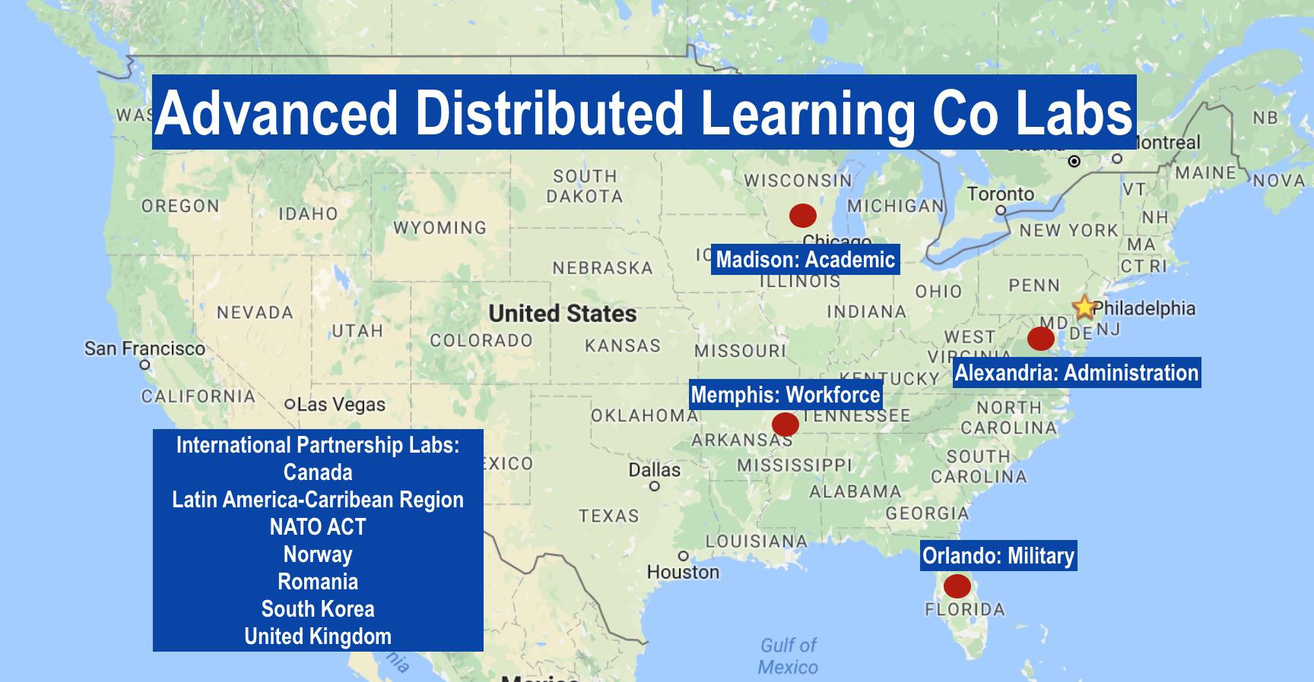

Slide 30
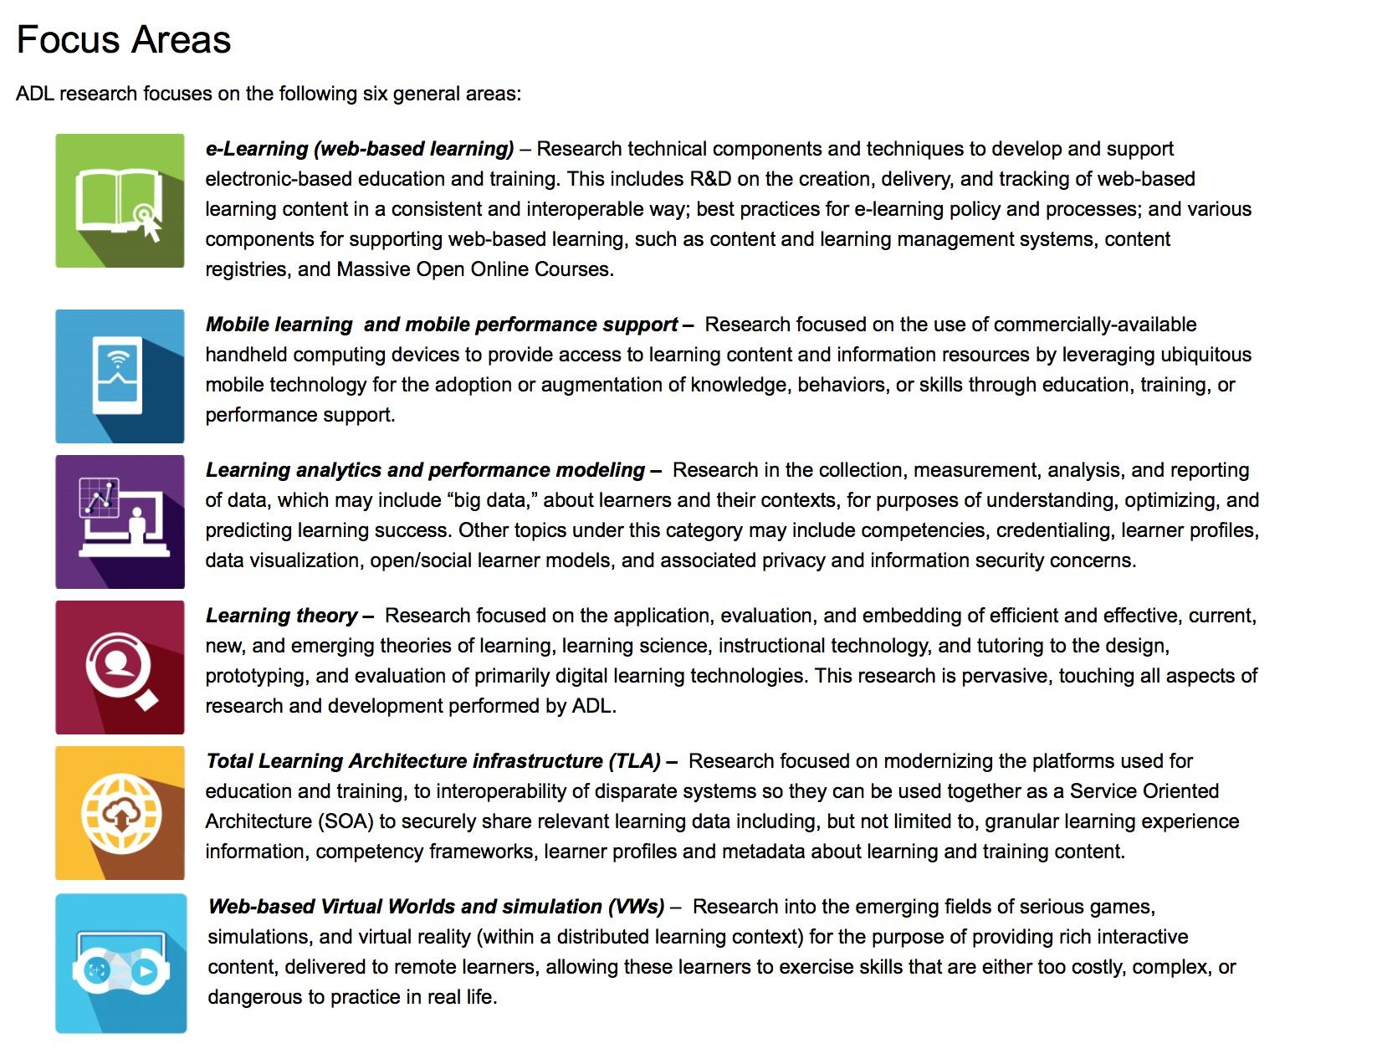
Ed Reform 2.0
Incorporates ADL Elements
Also:
“The Small Business Innovation Research (SBIR) Program at the U.S. Department of Education (ED) is operated out of its research arm, the Institute of Education Sciences (IES). ED/IES SBIR provides up to $1,050,000 in funding to small business firms and partners for the research and development (R&D) of commercially viable education technology products.”

Slide 31
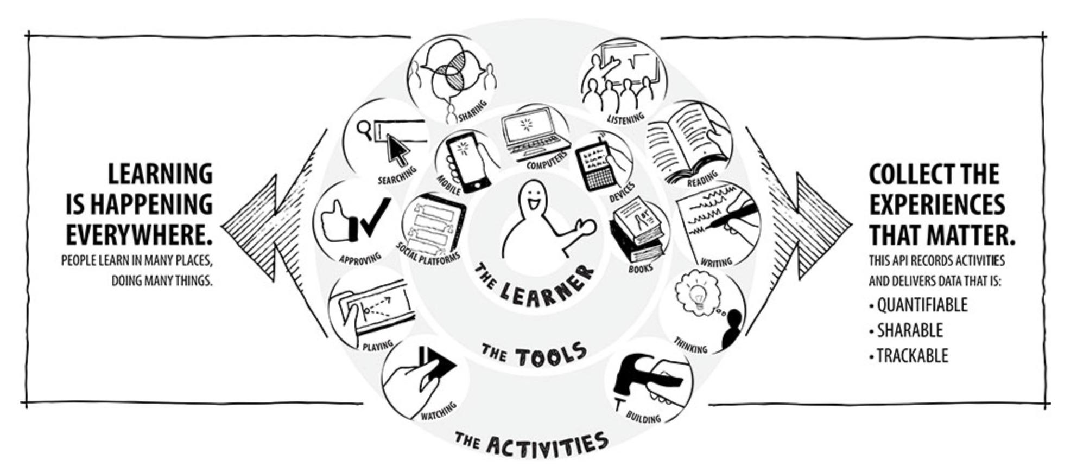
Expansion of ADL to Include Live Data Streams
“Broadly defined, the Experience API (xAPI) lets applications share data about human performance. More precisely, xAPI lets you capture (big) data on human performance, along with associated instructional content or performance context information. xAPI applies human (and machine) readable “activity streams” to tracking data and provides sub-APIs to access and store information about state and content. This enables nearly dynamic tracking of activities from any platform or software system—from traditional Learning Management Systems (LMSs) to mobile devices, simulations, wearables, physical beacons, and more.”

Slide 32
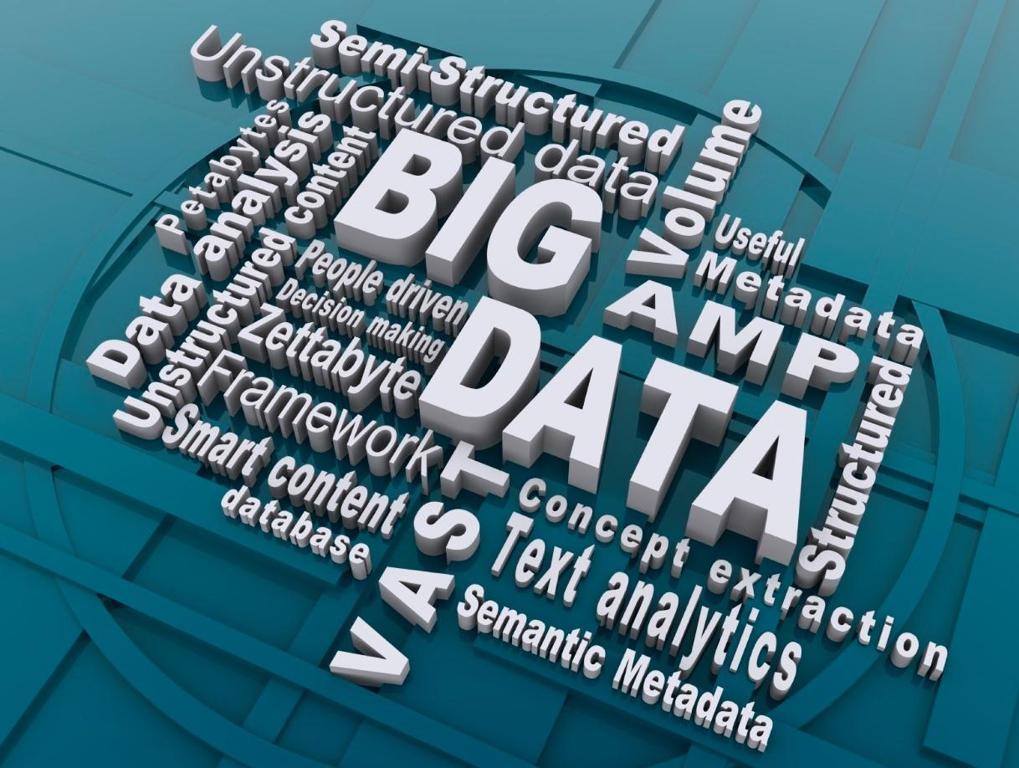
Big Data and Students
Politics and technology are intertwined.
Data is a virtual currency.
Data can be used for social control.
Data can be used to maintain power imbalances.
Data can be used to modify behavior.
Often, data collection is not transparent or under the control of the individual.
The amount of data being collected on students is expanding exponentially.
Education incorporating the “secret rules” of algorithms is a social justice issue.

Slide 33
How much data?
All of it please.
Academic Knowledge
Mastery of Skills
Behavior &
Social Emotional
Grit & Growth Mindset
Collection Methods:
Computer Log Ins
IDs-RFID Chips & Facial Recognition
Online Education Modules & Games
Classroom Management Software
“Fitbit” Type Devices
Device Cameras, Microphones, Screens
Surveys-Naviance, College Board, etc.
Community Partners
“Whole Child”
Data Collection
Family Situation
Trauma/ACES
Bio-Metric
Health
Facial Recognition

Slide 34
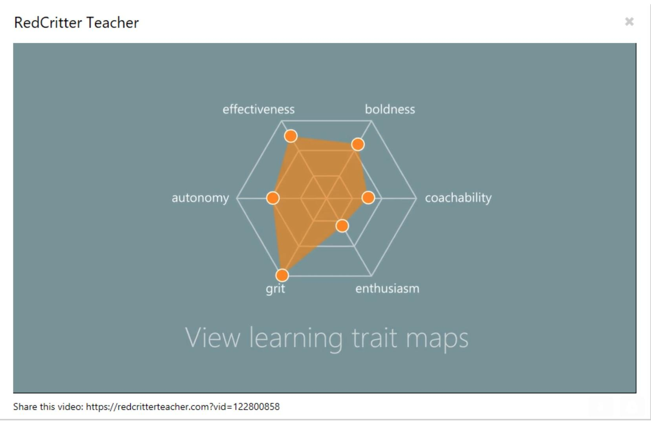
ESSA has thrown open the door to the collection of SEL data.

Slide 35
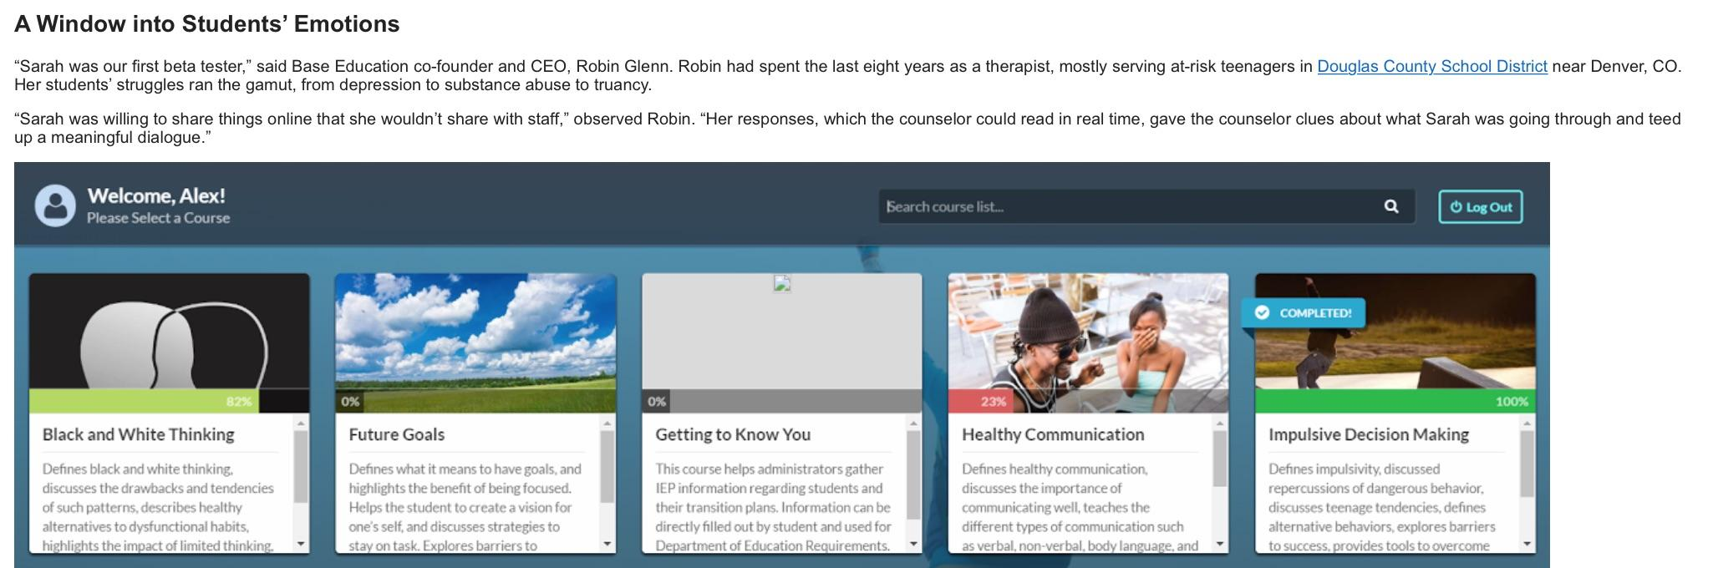
Social Emotional Online Learning Modules
Can be monitored by school staff - even deleted content.

Slide 36
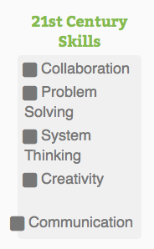
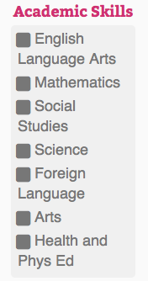
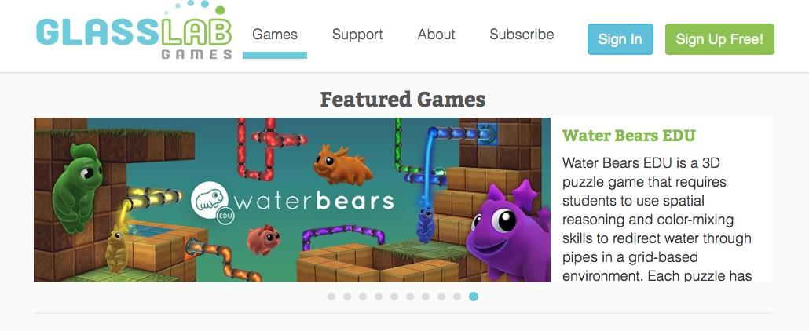
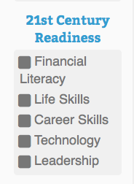
Gamification & SEL Data Collection
“Besides being an efficient and engaging educational tool, virtual environments also collects a lot of behavior data which can be used with Educational Data Mining (EDM) techniques to assess students' learning competencies.”

Slide 37
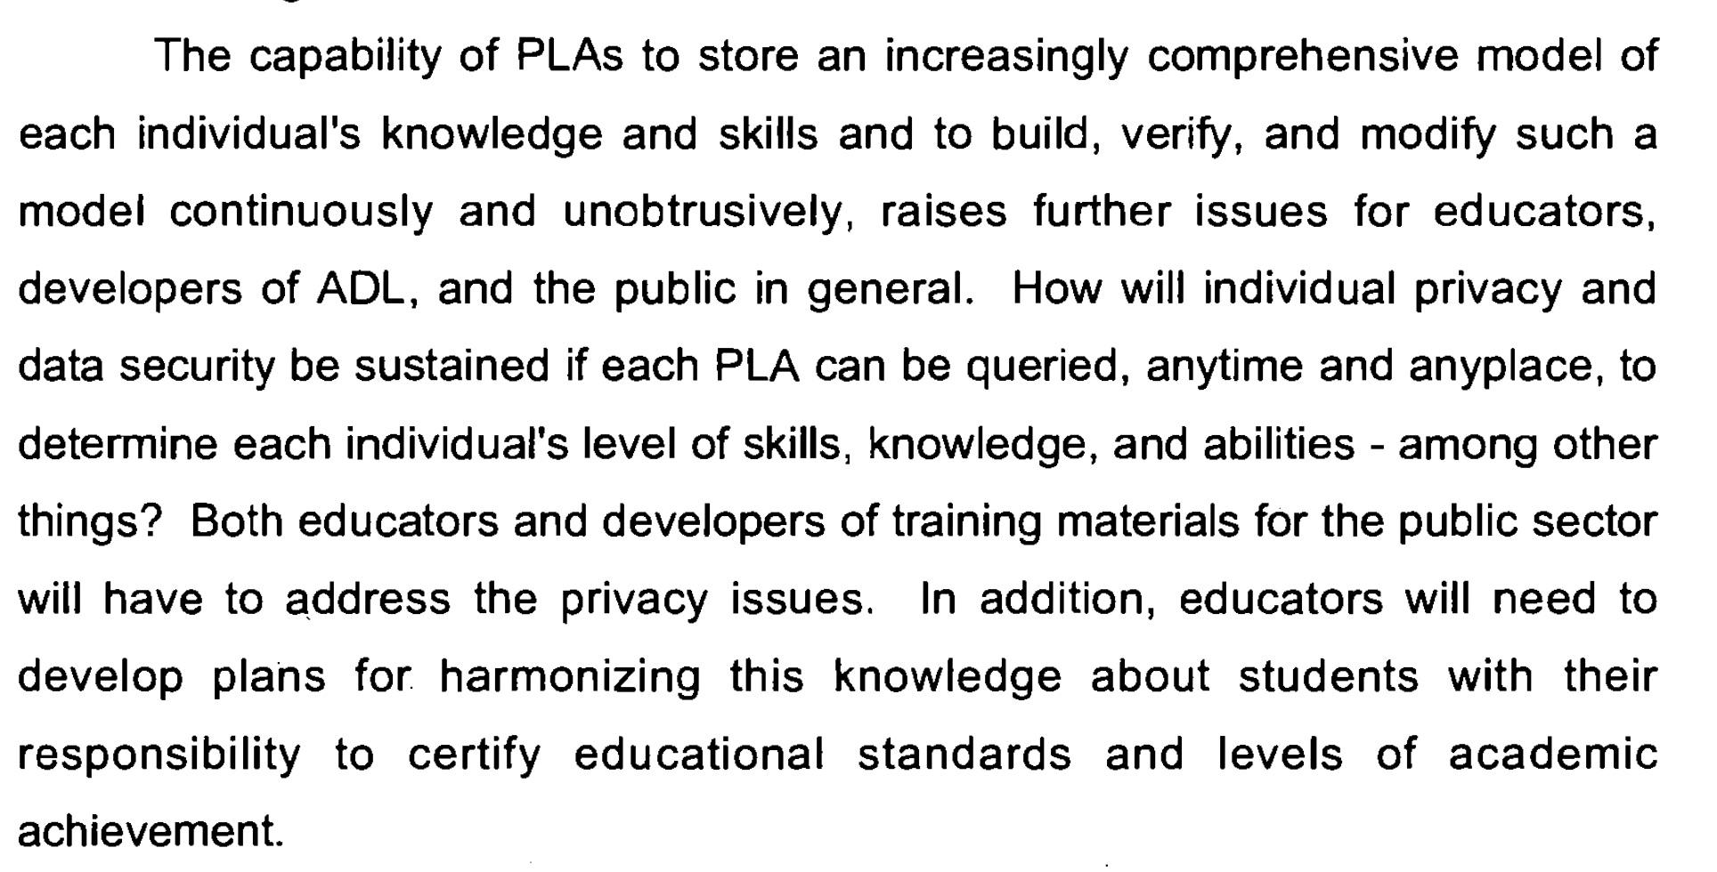
“Implications of the Advanced Learning Initiative on Education” 2003

Slide 38
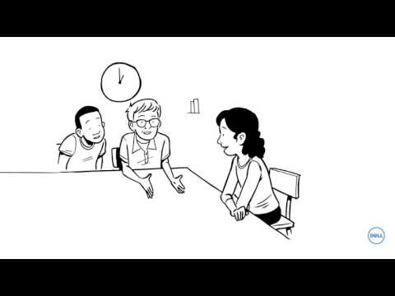
Dell is creating personalized learning options.
One of Dell’s major clients is the NSA.

Slide 39

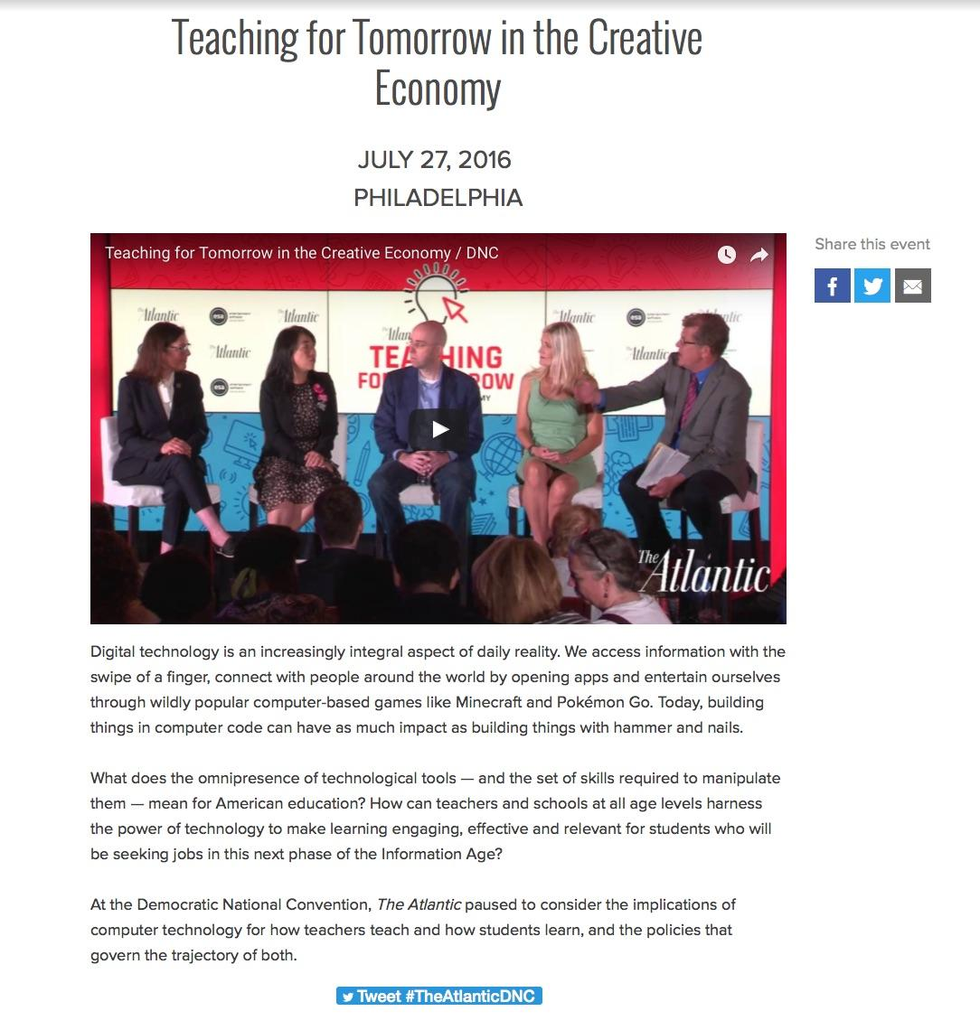
Sesame Credit

Slide 40
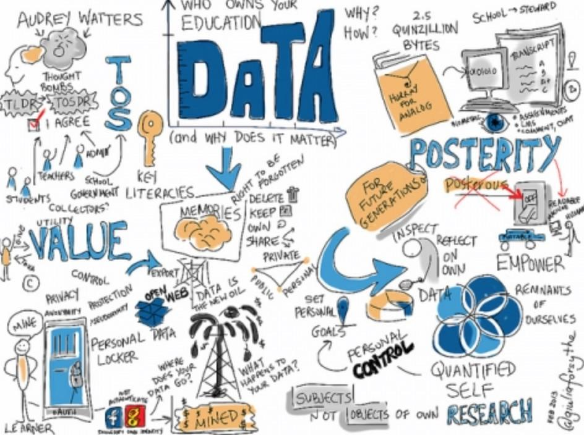
Online Learning
Stealth Data Collection Platform
When is your child’s data being collected?
Do you know it is being collected?
What data are being collected?
How are data being used?
Could your child’s data limit their opportunities?
Do you know how your child’s data can be disposed of?
Who controls the data? To what end?

Slide 41
Data-Driven Education
Personally Identifiable Information (PII)
Information that directly identifies an individual or that can be used to identify, contact, or locate specific individuals in conjunction with other data sets
Metadata
Data About Data
Open Education Objects
How was it created?
How is it used?
Who is the author?
When was it created?
Where is it stored?
File type?
File size?
How is it tagged-keywords?
AND/OR

Slide 42
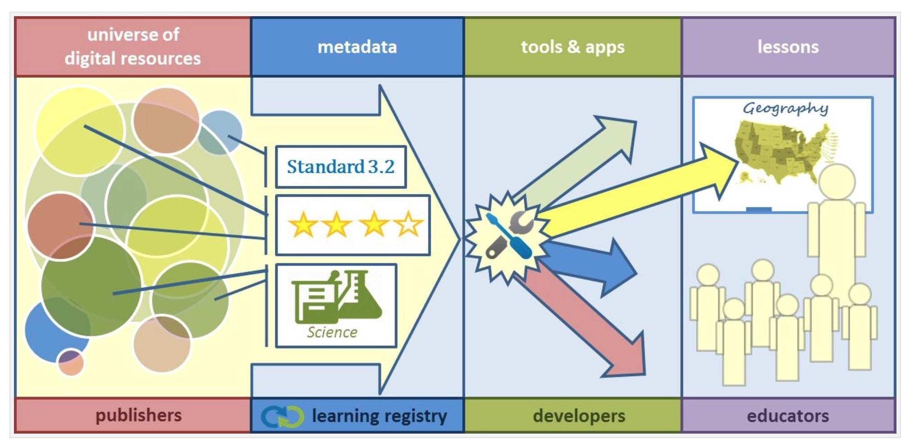
DoD’s ADL Initiative & Department of Ed Create the “Learning Registry”
“The LR is an open source technology framework to which any learning content providers (e.g., teachers, publishers, and curriculum developers) are able to share their content. Users are able to provide specific comments about which content they use, how they use it, and the efficacy of the content. Educators are then able to search within the LR by subject or standard. They can review and choose the most relevant and highly rated resource to present to their students.
The LR is a joint project between the U.S. Department of Education and Department of Defense’s ADL Initiative.”

Slide 43
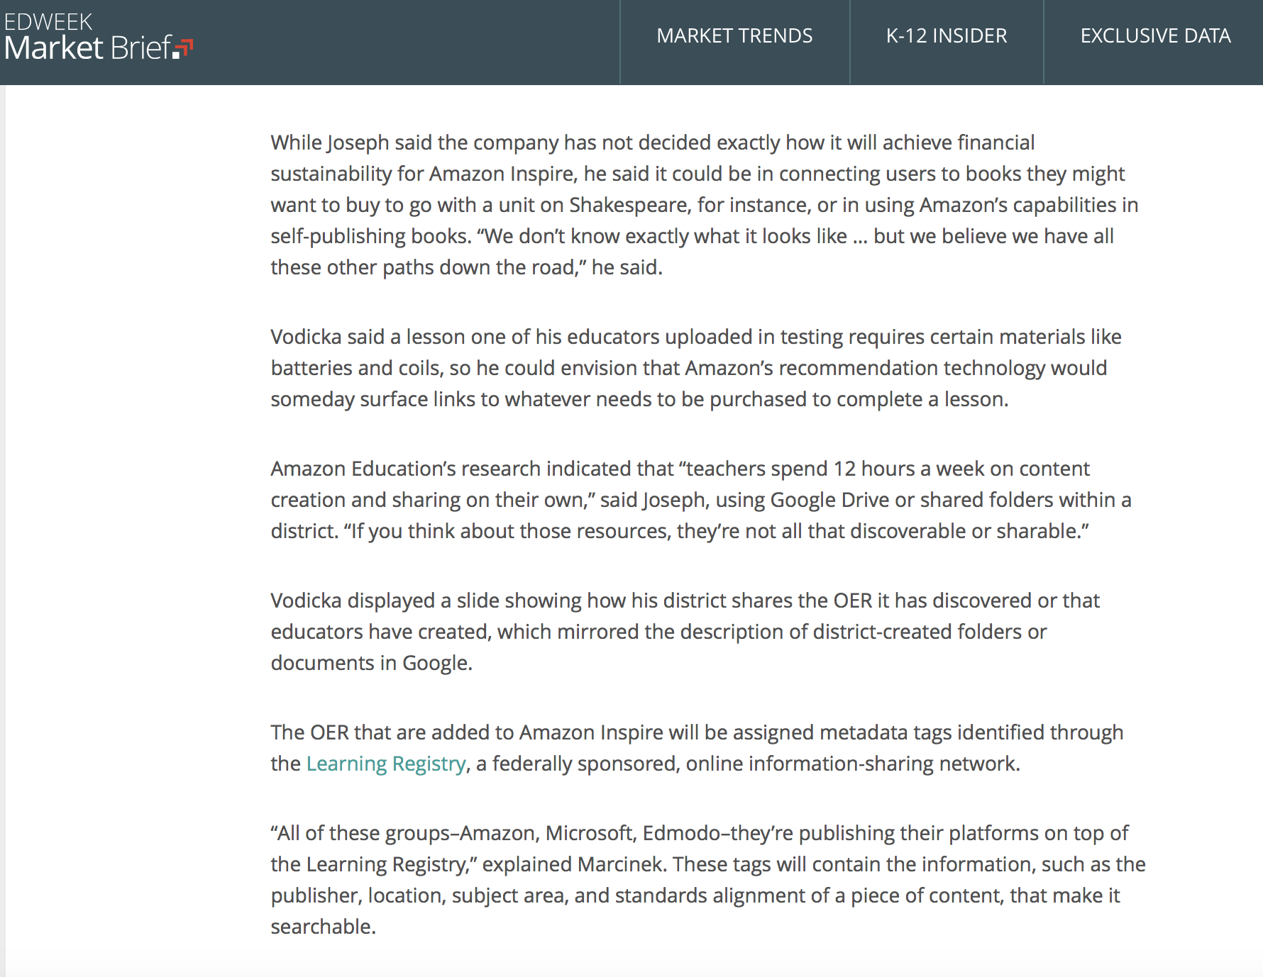
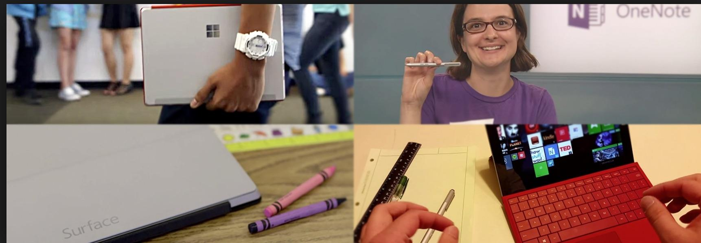
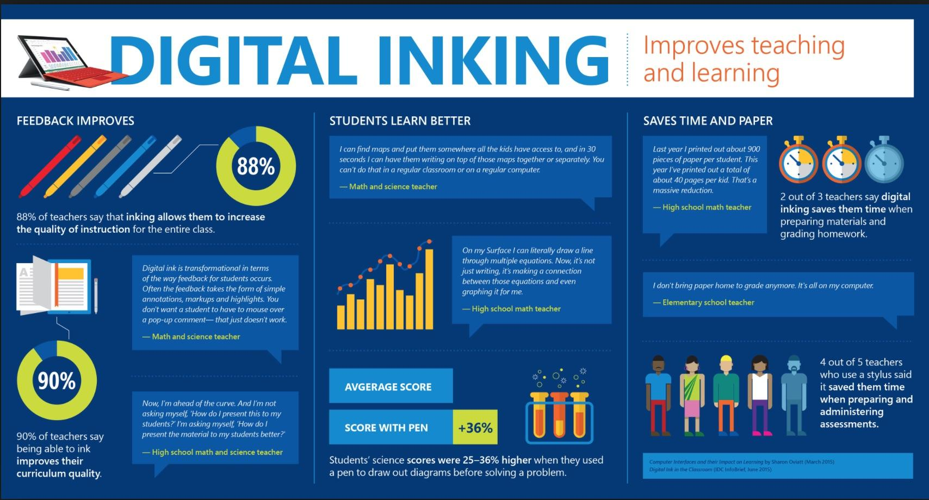
Microsoft Surface

Slide 44
Credit Flexibility
Out of School Time Learning
Badges

Slide 45
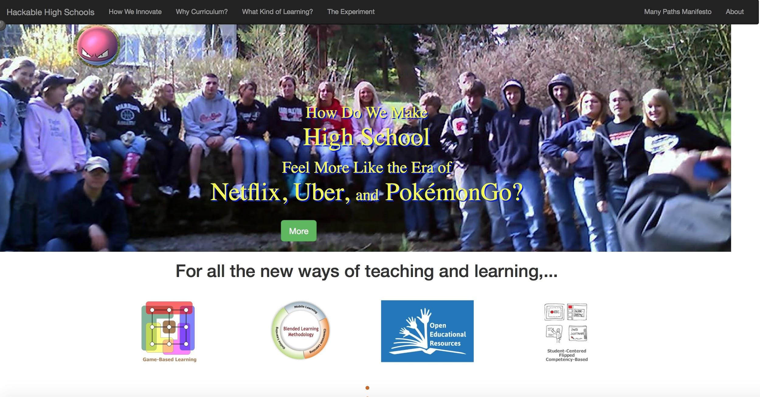

Slide 46
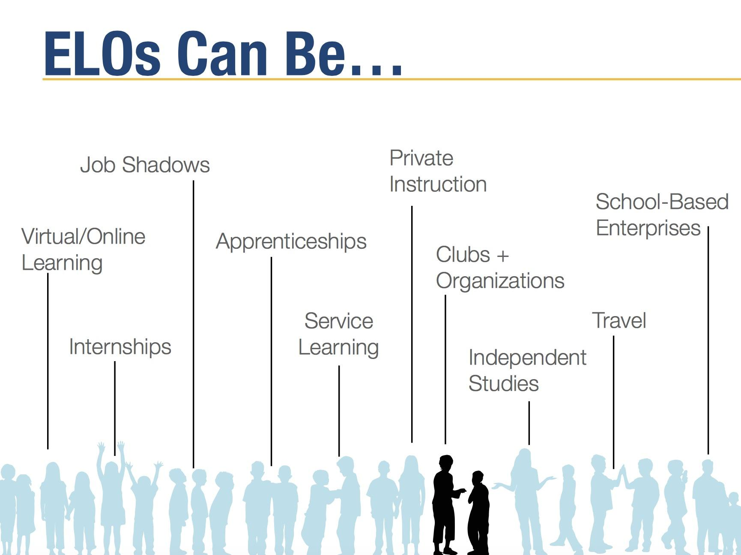
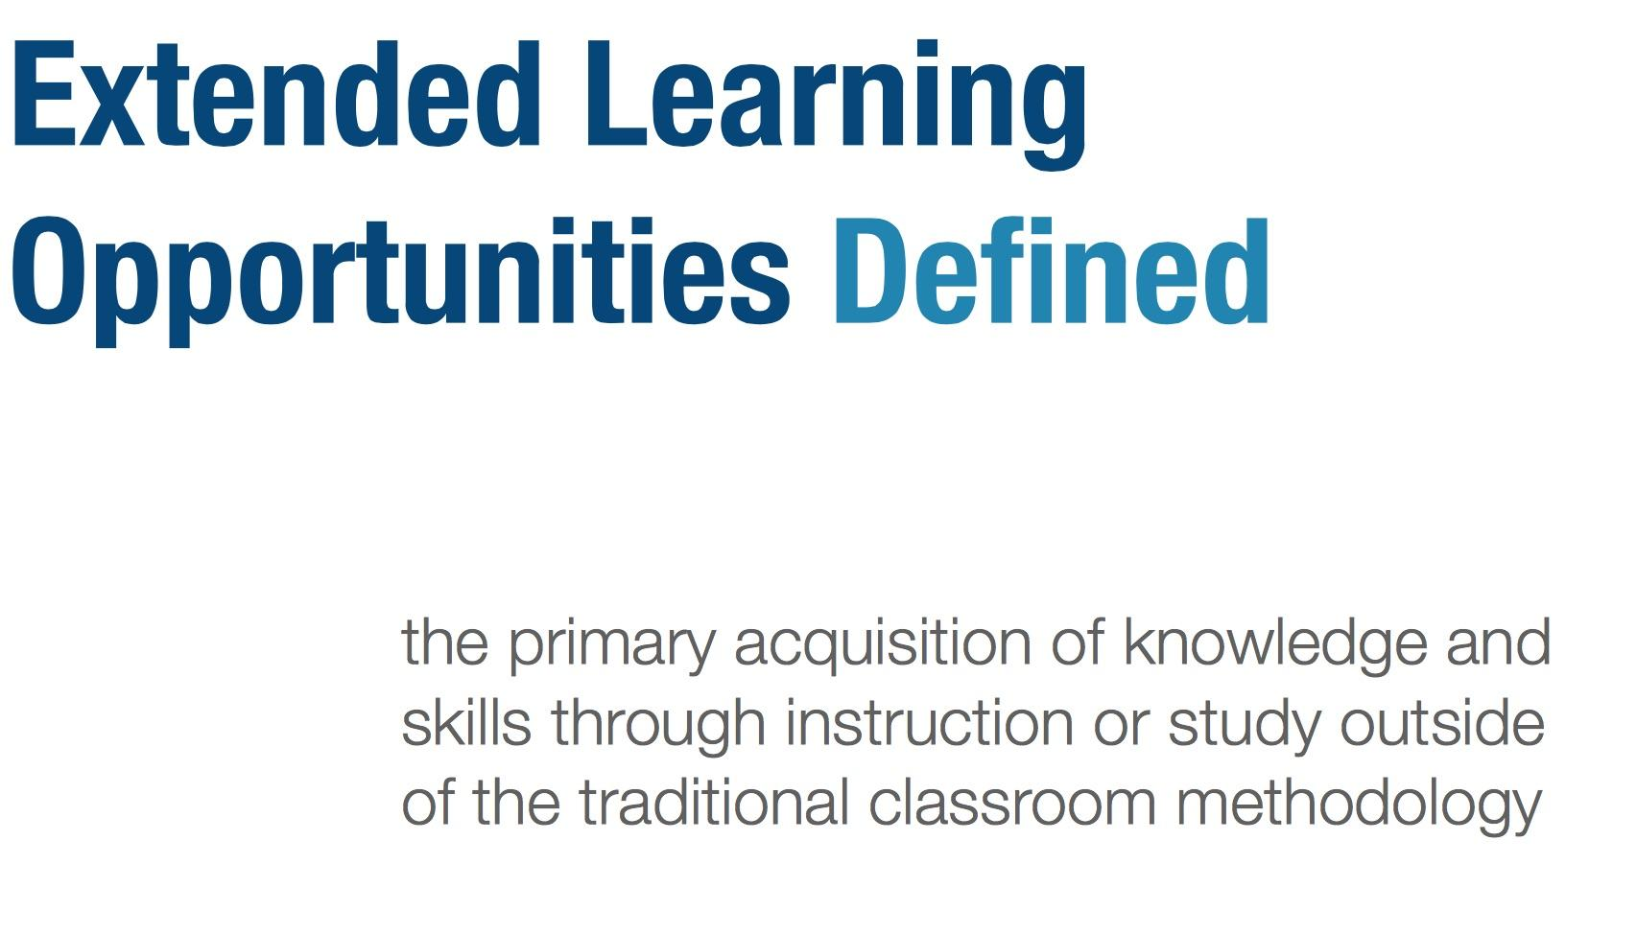
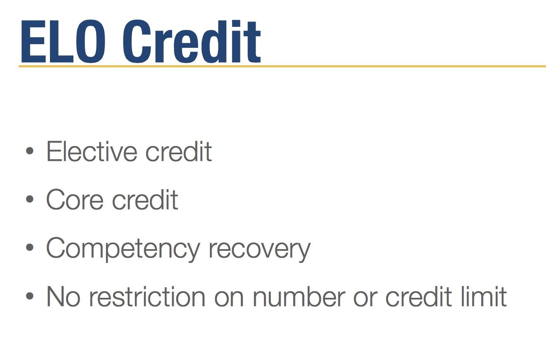
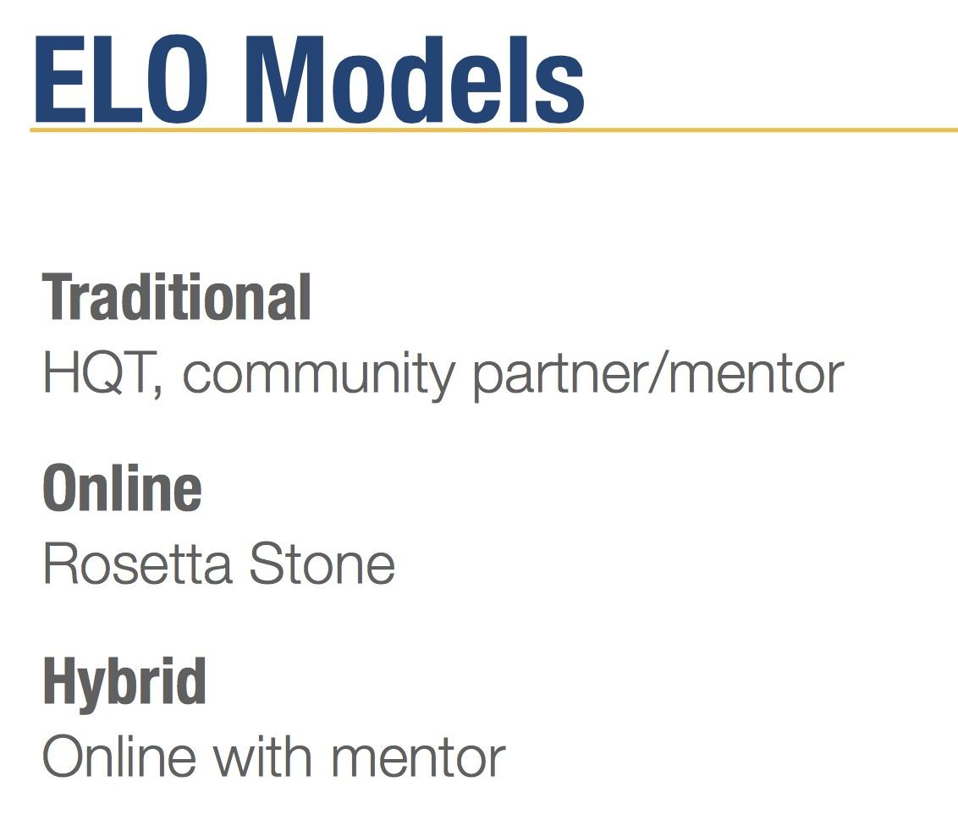
ELOs can also be cyber education.
“Keeping it Flexible: Extended Learning Opportunities in Today’s High Schools”
Great Schools Partnership, Webinar Series, 2014

Slide 47
ALEC’s Recent Digital Education Activities
STATEWIDE ONLINE EDUCATION ACT: creates a statewide program that provides high school students with access to online learning options regardless of where the student lives. The options are designed to be high quality and allow for maximized learning potential by focusing on student mastery of subjects at their own pace and own time, instead of the traditional seat-time learning requirements. Amended January 2016
DIGITAL TEACHING AND LEARNING PLAN: requires the State Board of Education to develop a digital teaching and learning plan to prepare the state to implement a statewide initiative that will result in dramatic improvements in student achievement. Finalized January 2016
ONLINE LEARNING CLEARINGHOUSE ACT: creates a clearinghouse through which school districts may offer their computer-based courses to students of other districts. Amended January 2016
NEXT GENERATION CHARTER SCHOOL ACT amendment passed in September 2016 eliminates special distinctions between virtual and non-virtual charter schools. Amended September 2016
RESOLUTION ON STUDENT CENTERED ACCOUNTABILITY SYSTEMS including “timely provision of student-level data, measure student-specific progress and restore the focus of high-stakes testing to be on advancing individual student instruction and growth.” Finalized September 2016

Slide 48
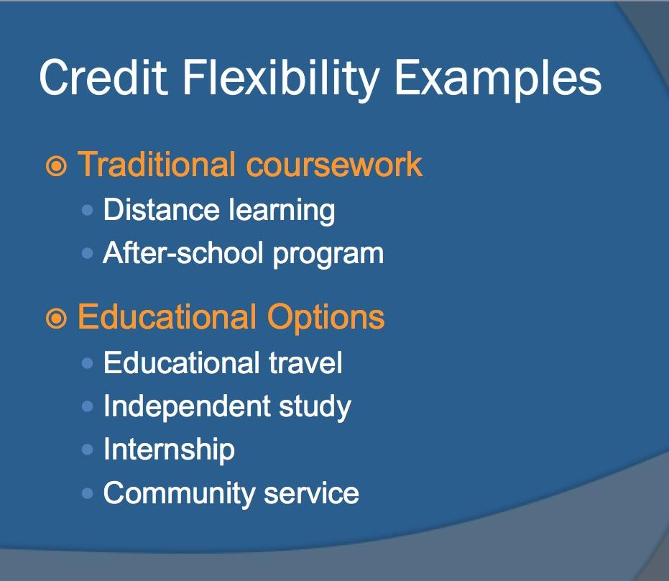
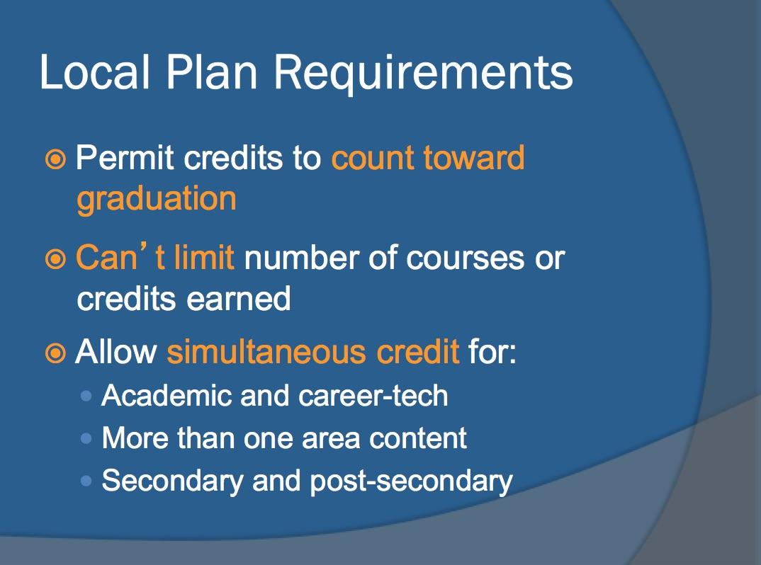
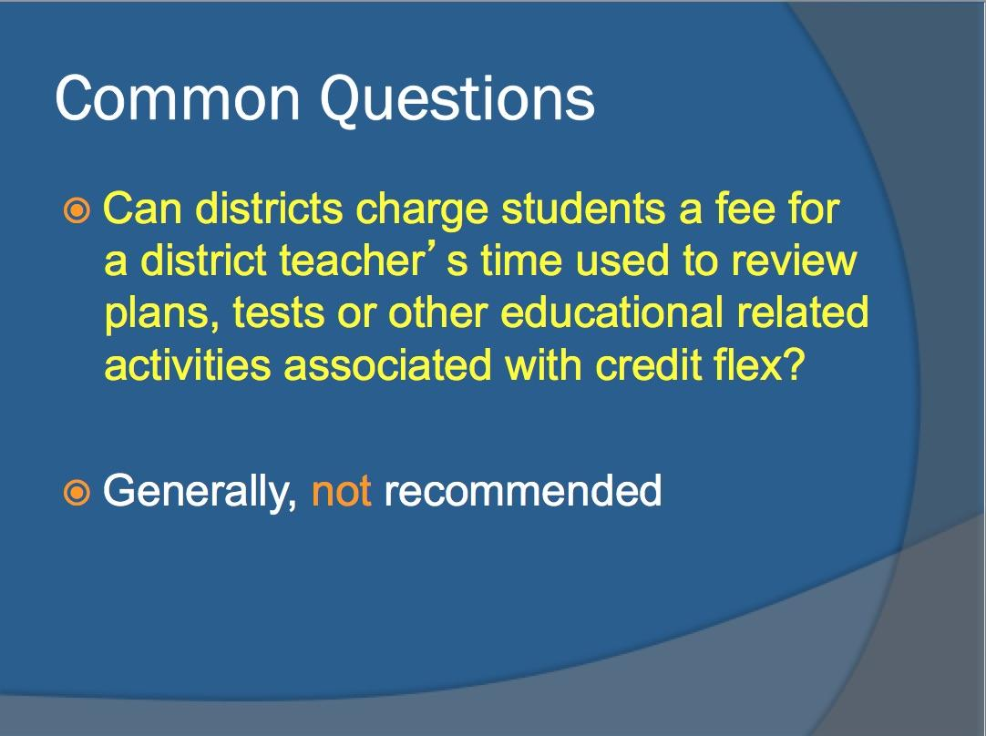
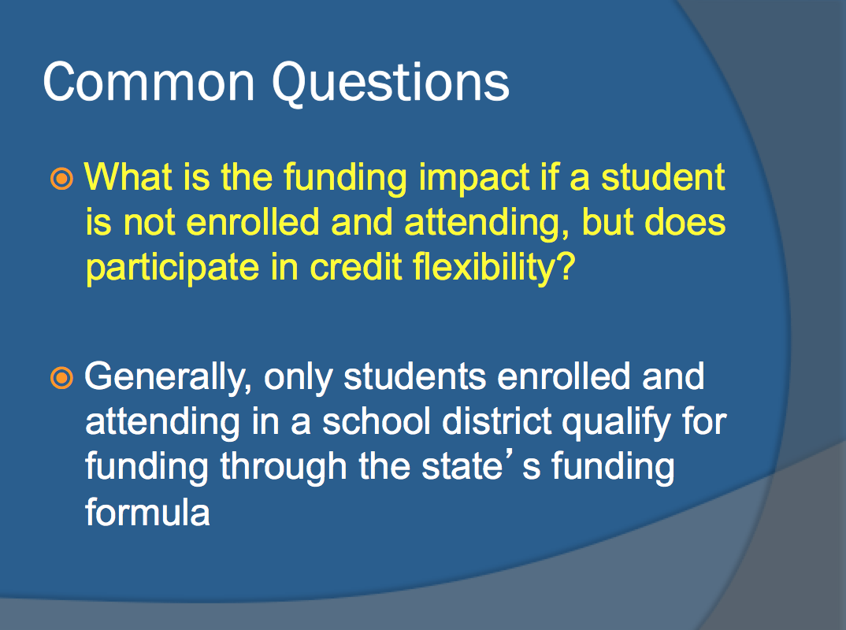
Ohio Credit Flexibility Legislation

Slide 49



What’s happening in Philadelphia?

Slide 50

ELOs & Workforce Training
Students today are encouraged to identify career pathways as early as middle school. By high school many are supposed to have Individual Career & Academic Plans in place.
Increasingly, children are viewed as human capital to meet the needs of the economy.
Education now emphasizes acquisition of skills over exercising intellectual curiosity.
ELOs are consistent with workforce training, since many of these “learning opportunities” involve a career component. It also provides a means whereby a student’s “soft skills” can be assessed and documented in a project-based setting.
There is great pressure to lift restrictions on sharing student records across federal agencies and to research institutions, so as to facilitate the flow of education-workforce data.

Slide 51

It’s all in how you frame the conversation, and the reformers have a head start.
Innovative
Student-Centered
Personalized
Adaptive
Blended-Hybrid Learning
Formative (Stealth) Assessments
Gamified Education Software
1:1 Devices Initiatives
Untested
Isolated
Data-Mined
Controlled
Limited Access to a Human Teacher
Online Surveillance
Behavior Modification
Data Gathering Platforms

Slide 52
If you are interested in reading more thoughts on digital education by a skeptical parent, visit:
A Wrench In The Gears
https://wrenchinthegears.com/

